Slide 1

Annual Report
2018
25 Years of Protecting Watersheds

Slide 2
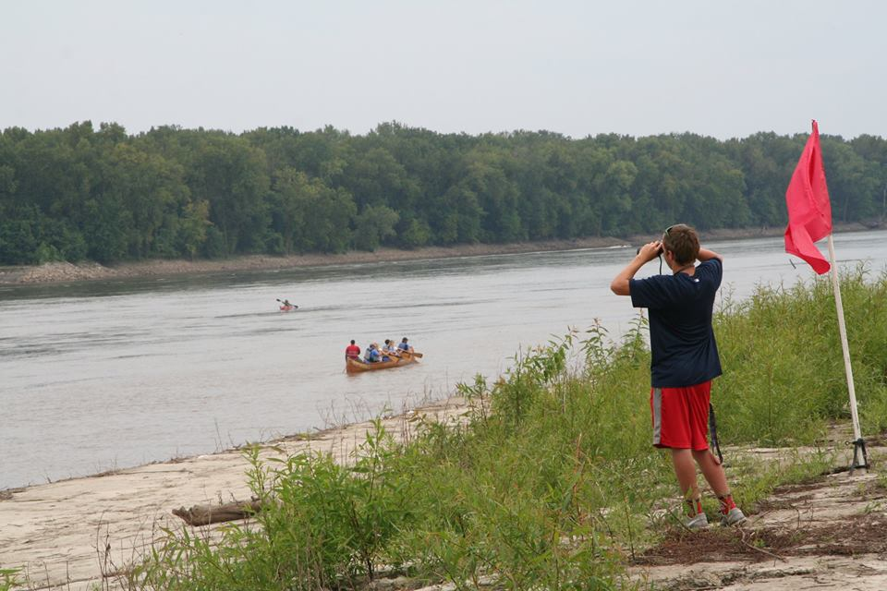
25 Years of Protecting Watersheds
Welcome
Remarks by Gary Heggs
Guest Speaker Bryan Hopkins
2018 Annual Report
Awards
Election of Officers

Slide 3
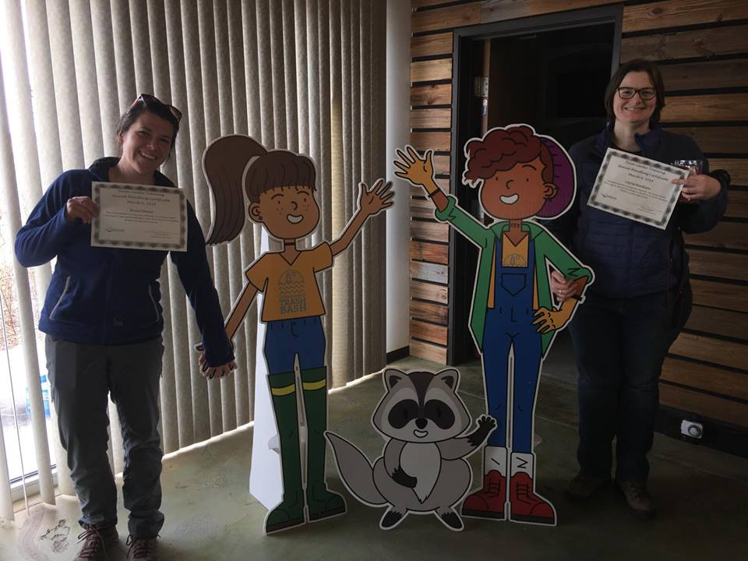
Team Leader Training Special Handling

Slide 4
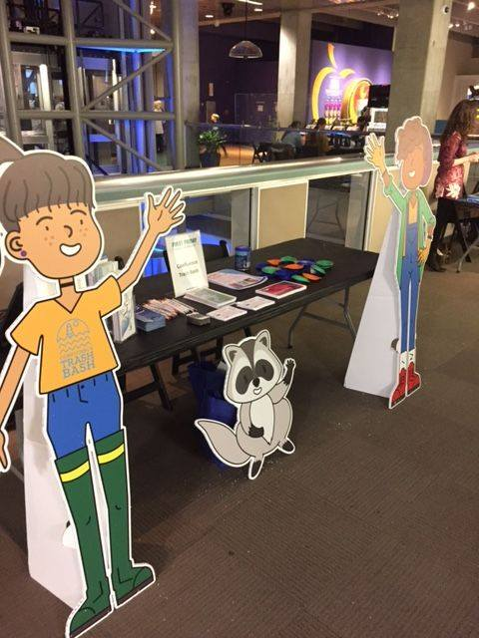
St Louis Science Center First Friday
Outreach
72 people
Sign up for CTB

Slide 5

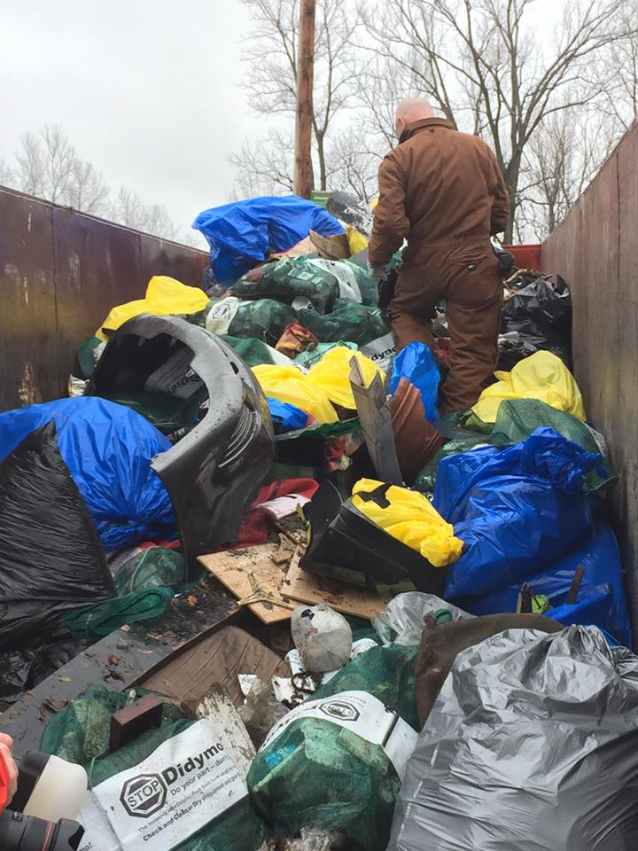
Confluence Trash Bash
Coordination
8 rendezvous locations
401 participants
15 tons of trash
176 tires
1 ton recyclables
1 ton metal
70 Inlets marked

Slide 6
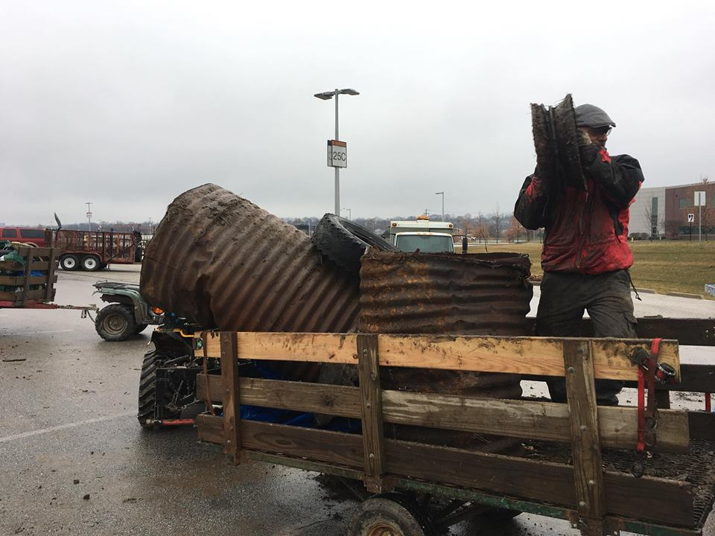
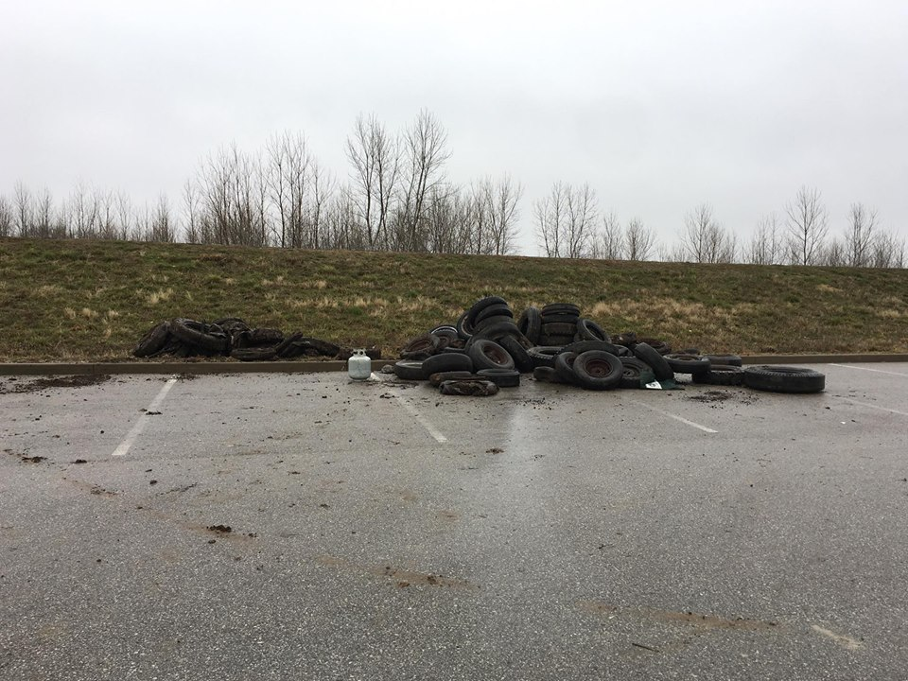
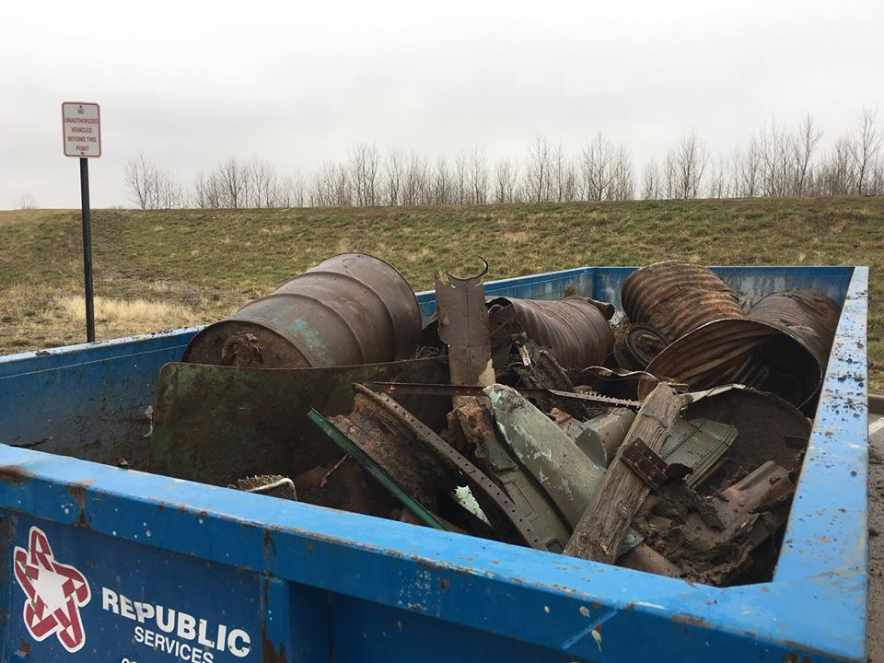
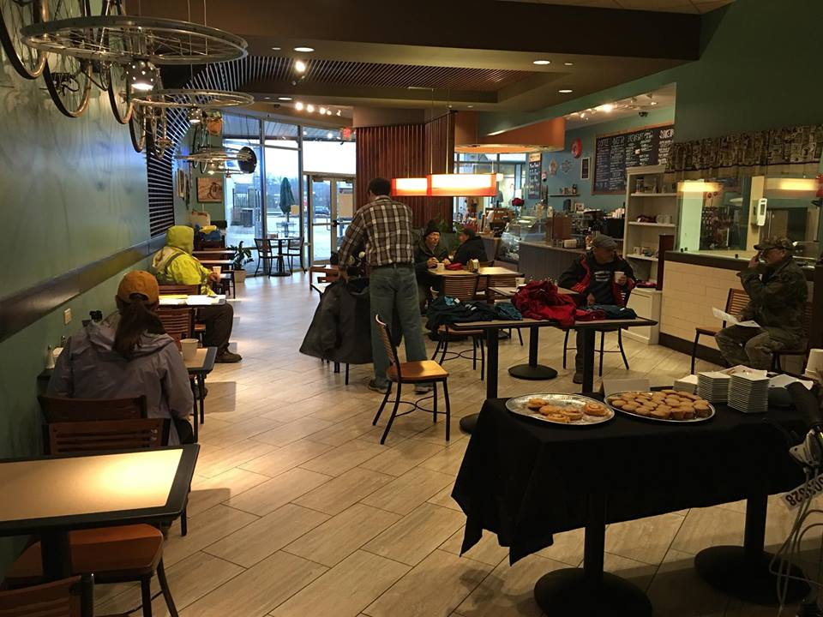

Slide 7

Meet Chloe and Jayden

Slide 8
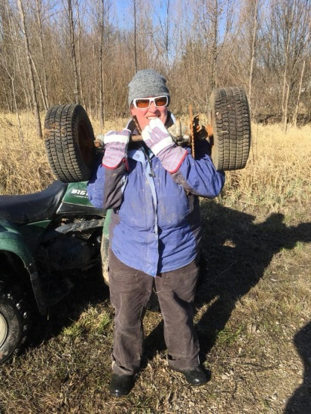
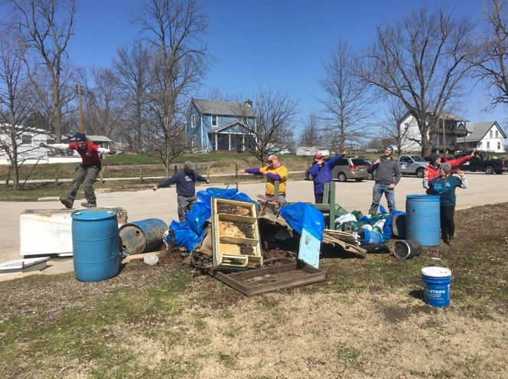
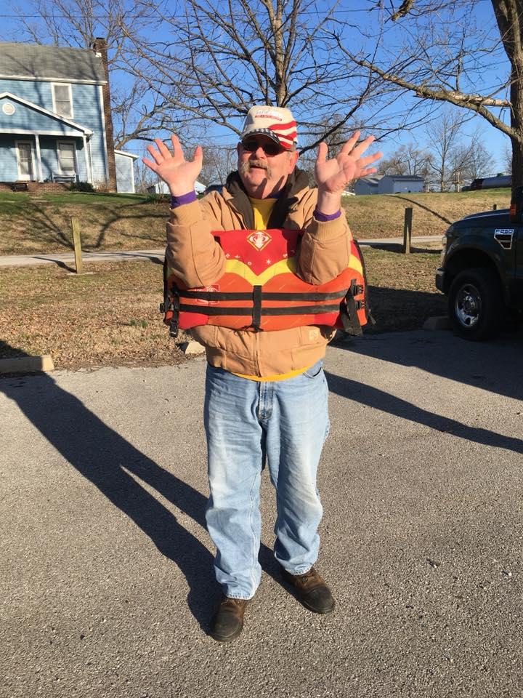
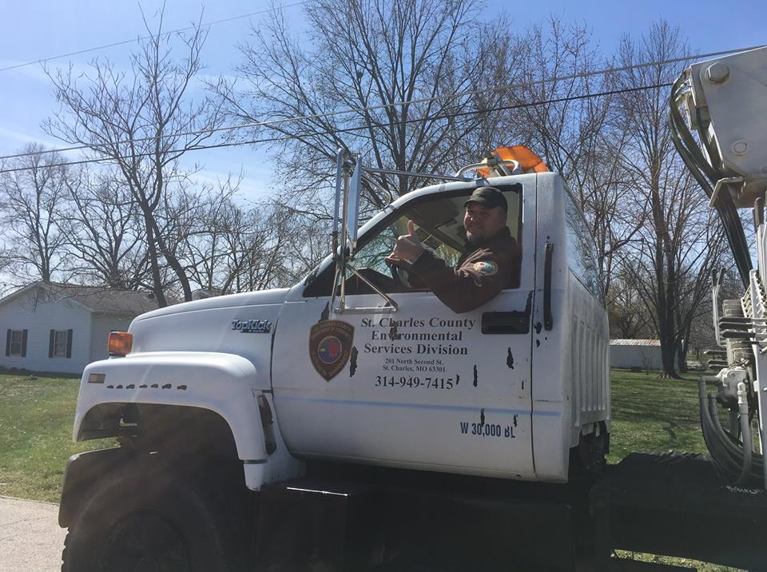
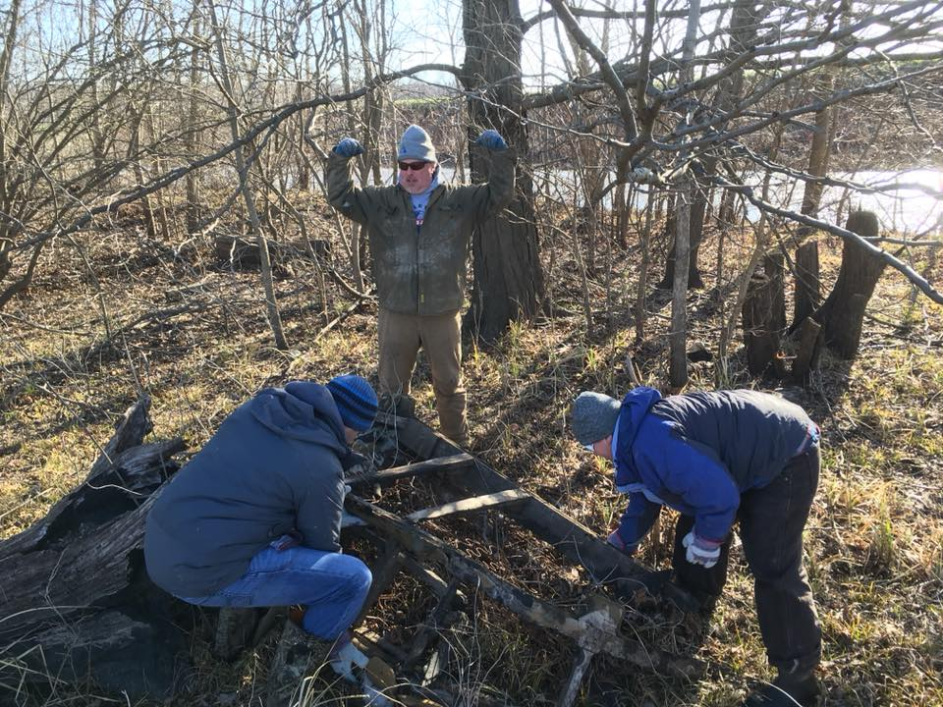
Mission: Clean Stream
143 volunteers
4 tons trash
10 + tires
GM Earth Day
Weather cancellation

Slide 9
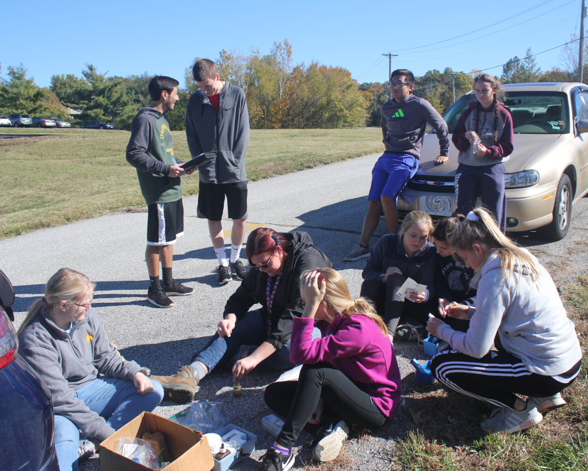
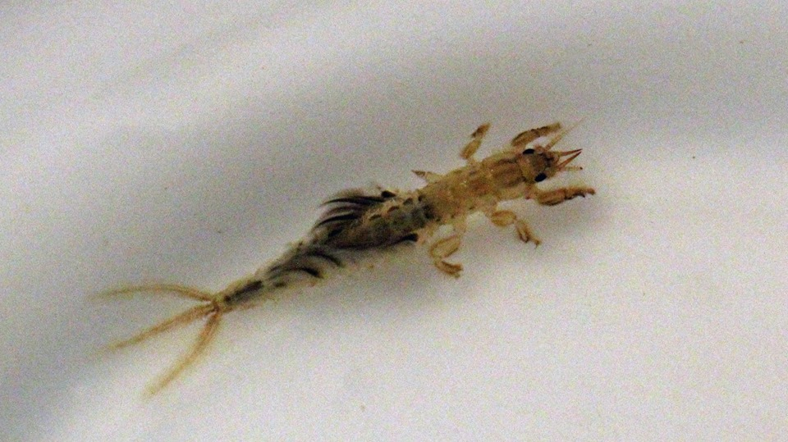
Dardenne Days
Spring and Fall
Length of stream water quality monitoring
34 sites
43 volunteers
19 E.coli Tests

Slide 10
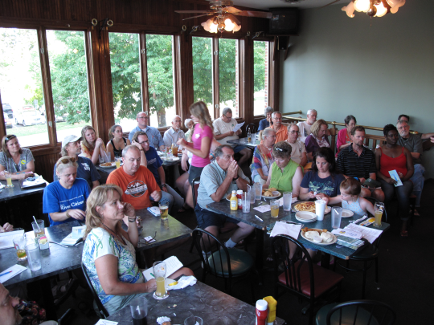
Big Muddy Speaker Series
10 presentations
In support of the Big Muddy Refuge in cooperation with Missouri River Relief
Many thanks to Big A’s for providing the venue and speaker meals.

Slide 11
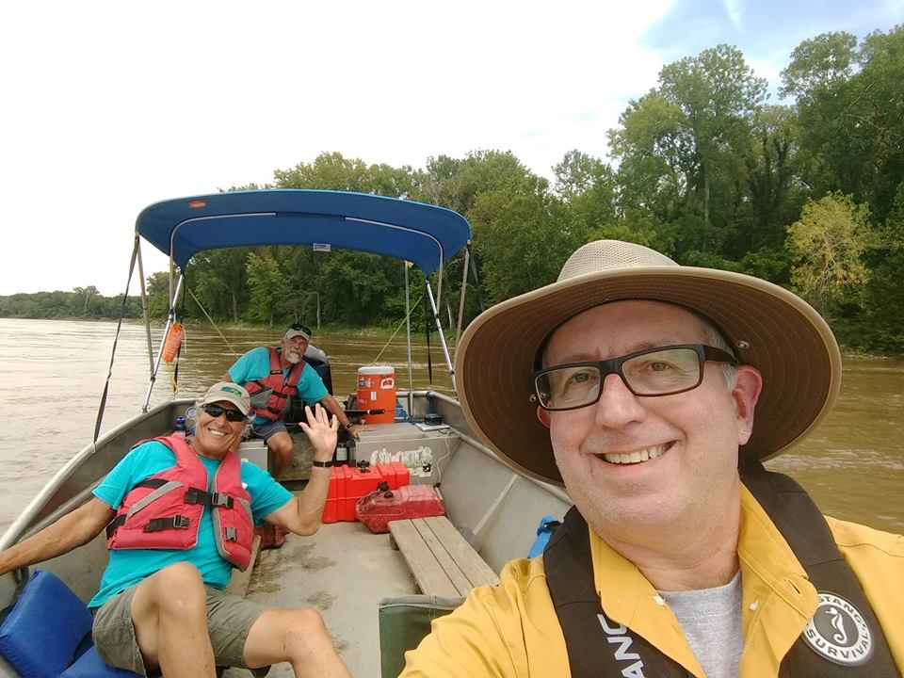
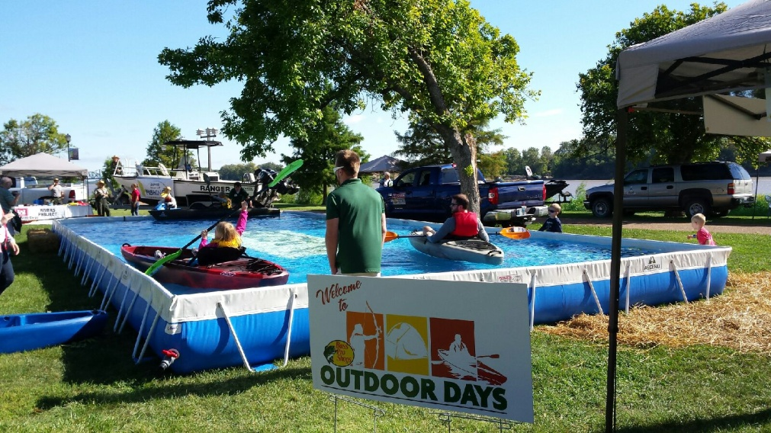
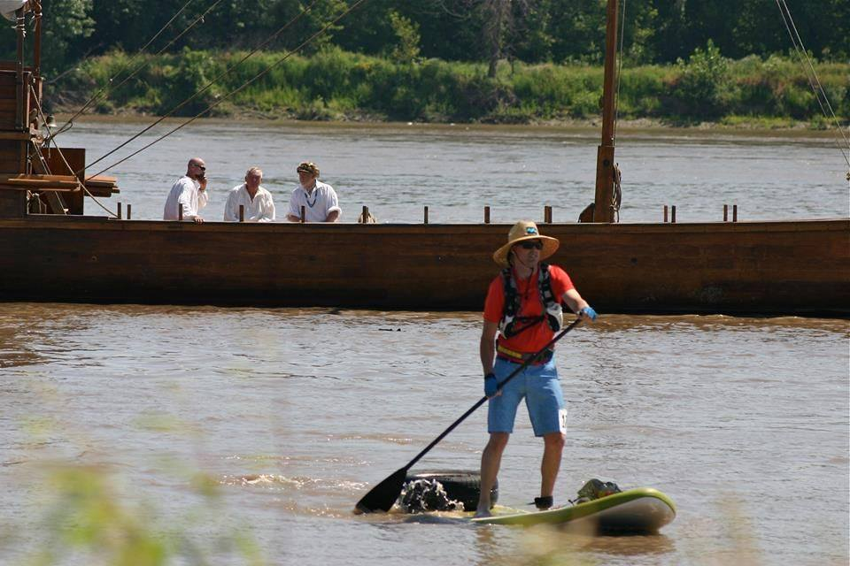
Race for the Rivers featuring Bass Pro Outdoor Days
102 Boats
2000 attendees
25 student volunteers
Race for the Rivers Bass Pro Outdoor Days 2018 video

Slide 12
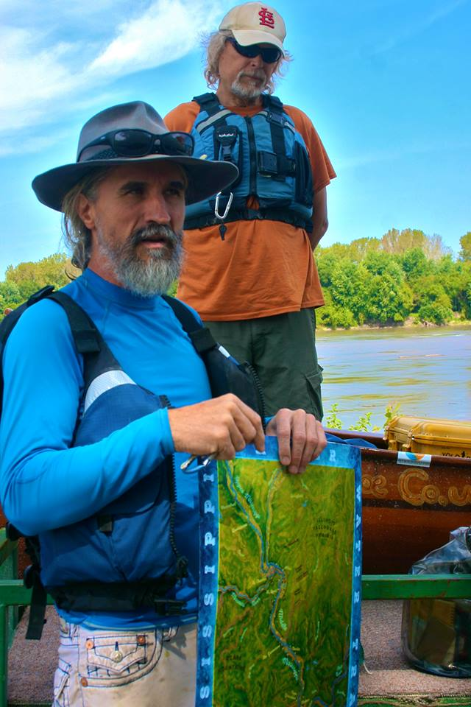
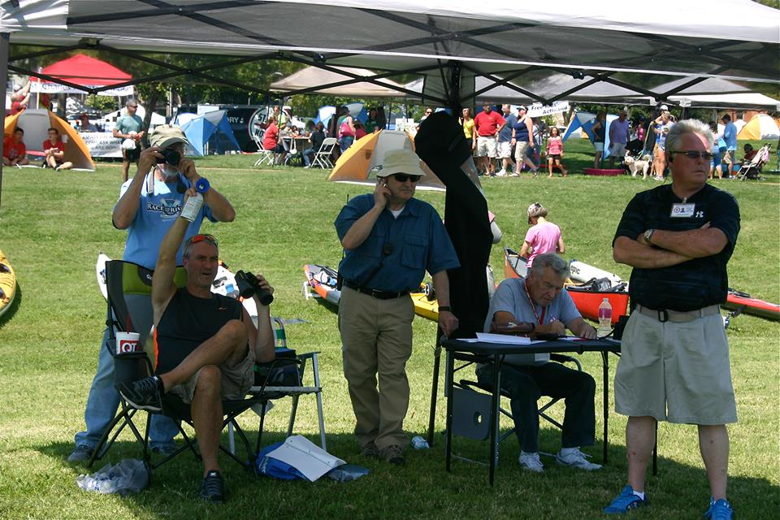
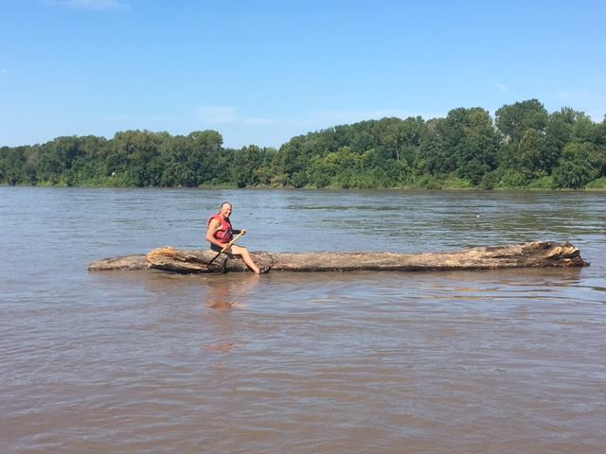

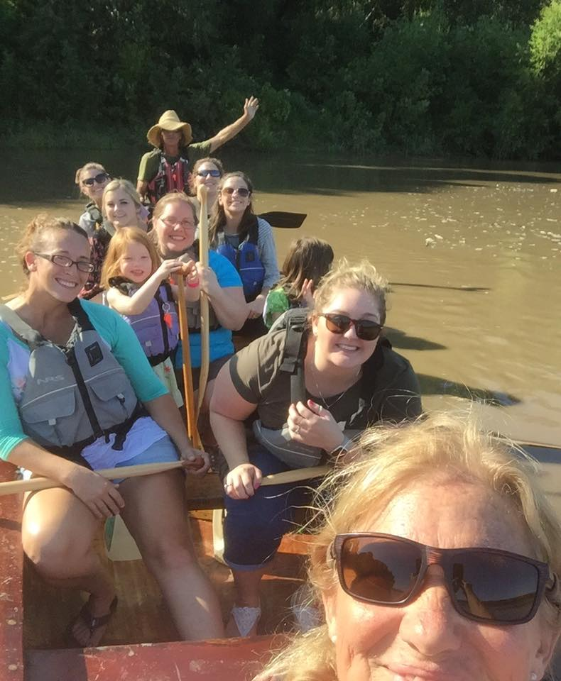
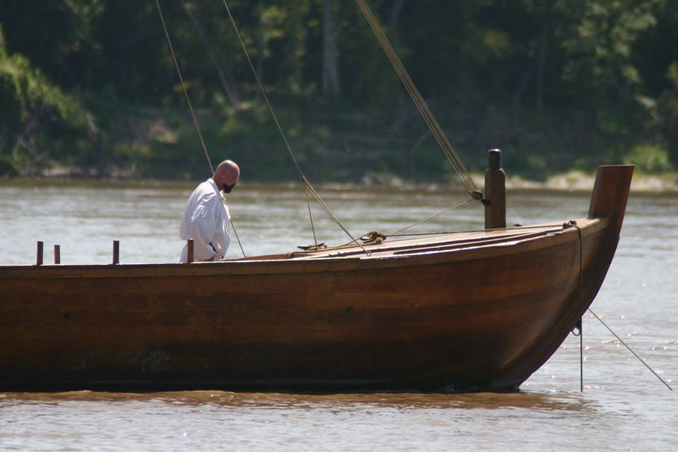


Slide 13
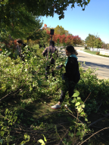
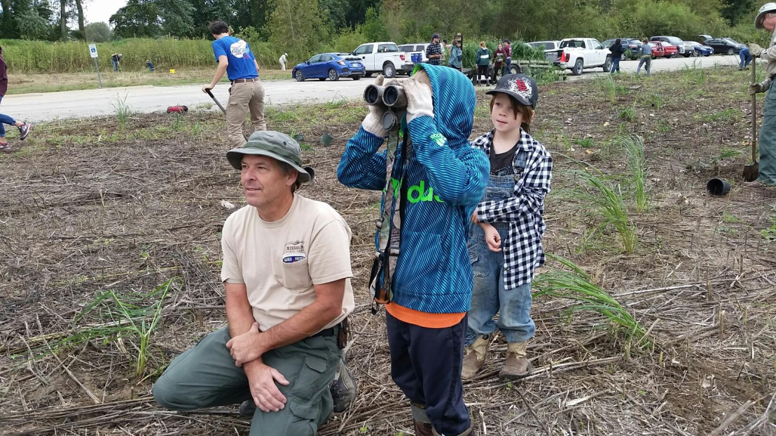
River Ring Honeysuckle Hack
Fox Hill Park.
13 participants
8 Student volunteers

Slide 14
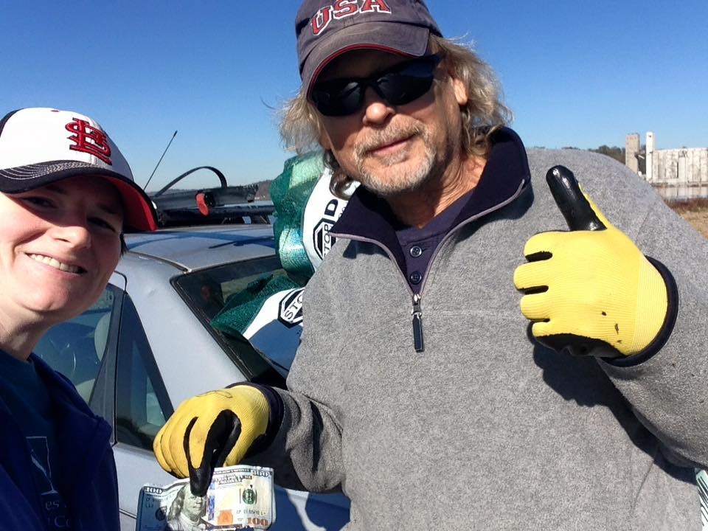
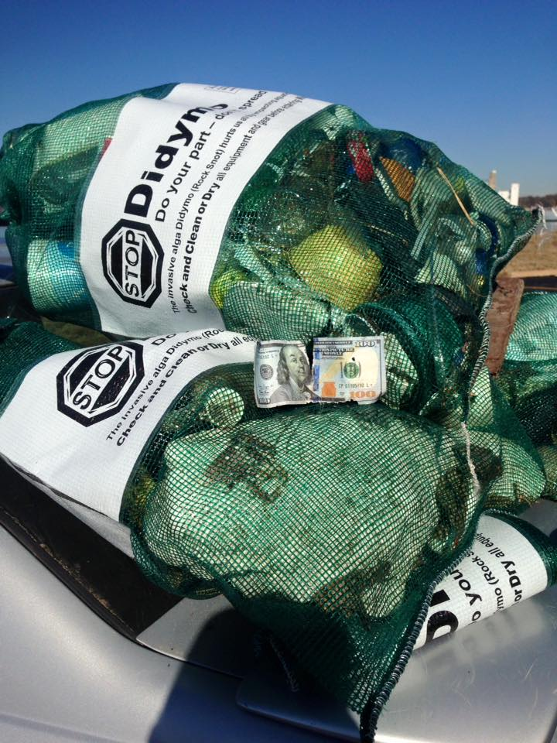
Small Group Work Days
Confluence Conservation Corps
6 clean up events
6 Honeysuckle removal events.

Slide 15
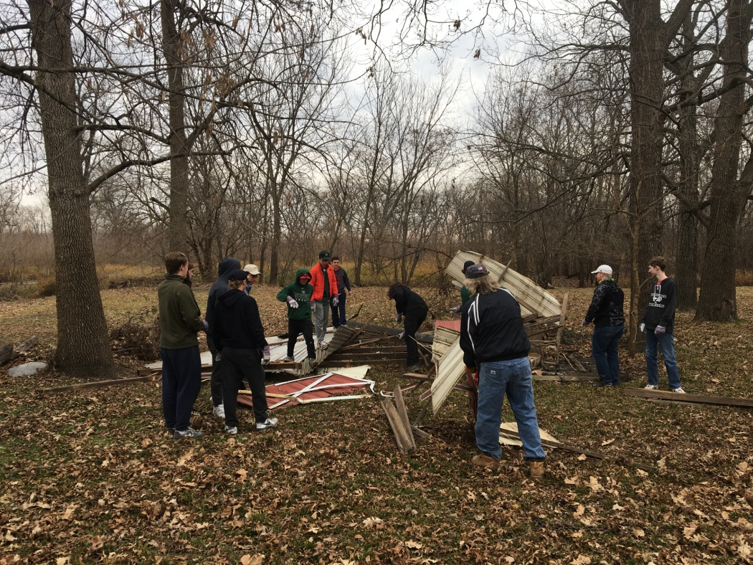
School Group Activities
Jennings Middle School
R4R (30 student volunteers)
Grand Glaize Hancock Place HS Stream Team Workshop (120 student volunteers)
Green Fair at St. Louis Flo-Valley Community College

Slide 16
Participated in or represented GN
Stream Teams United
Great Rivers NPLD planning meeting
Pelican Day planning meeting
Powder Valley Meet and Greet
Conservation Federation Affiliate Meeting

Slide 17
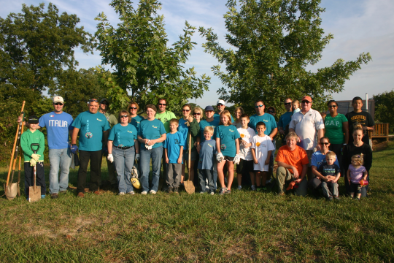
And…
Pelican Day
National Public Lands Day at the Confluence
100+ volunteers
Earth Day St Louis
MO AM Water
Watershed Festival

Slide 18
Collaborators
Great Rivers Habitat Alliance
Missouri Sierra Club,
Missouri Audubon,
St Louis Audubon,
1Mississppi,
Missouri Coalition for the Environment, Mississippi,
Missouri River Water Trail Association
MDC,
MoDNR,
USFW,
USACE

Slide 19
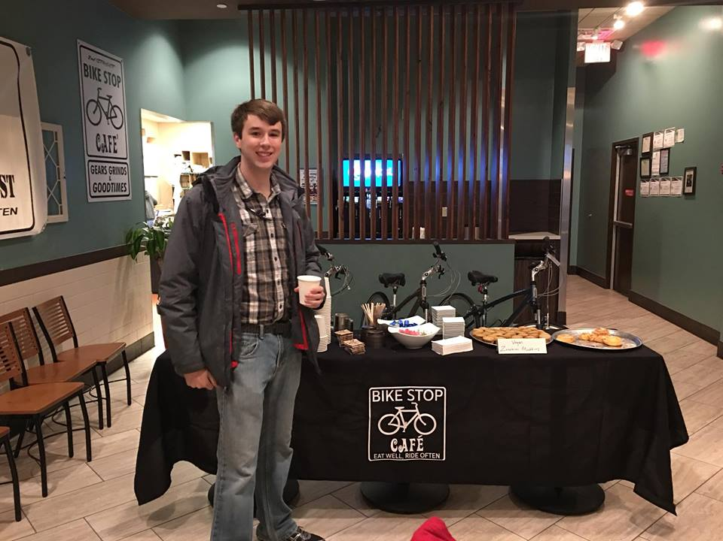
Sponsors
Mrs Pat Jones
Thought Process Interactive
Missouri American Water
GM Wentzville
Great Rivers Greenway
Metropolitan Sewer District
Walmart – Wentzville
Sams Club – Wentzville
Bridgestone Tires

Slide 20
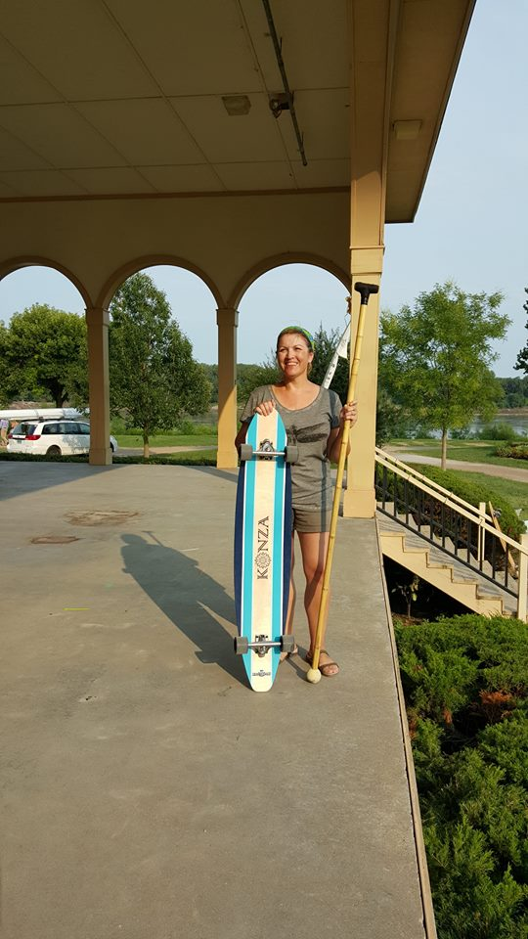
Sponsors (Cont)
J&M Family Enterprises
Ms Judy Mulholland
Race Owl
Alpine Shop
Ladsurfski
Panera Bread
Republic Services
Progressive Waste Management
Robert Sanders Waste Systems
Dumpsters.com
Junk Car Medics
Ziegemeyer Insurance Agency

Slide 21
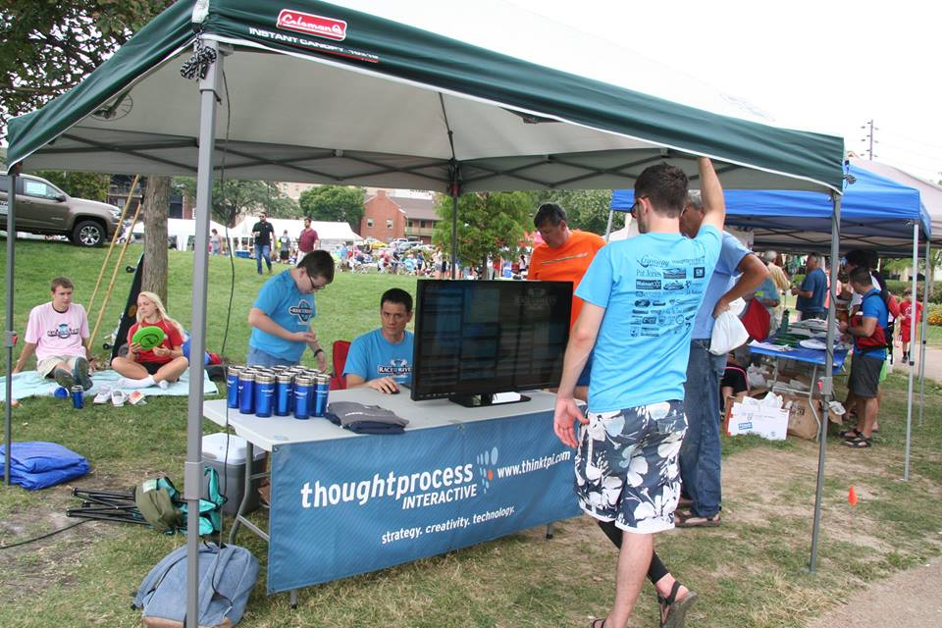
Generous Assistance Provided by
Big Muddy Adventures
St Louis Audubon
Revolution Cycles
Bike Stop Café
Katy Trail Bike Shop
Missouri Master Naturalists
Cities of Wentzville, Dardenne Prairie, Cottleville, St Charles, O’Fallon, Lake St. Louis, City of St Louis, Bridgeton, Overland, Maryland Heights, Florrisant and St Louis County.
Missouri Department of Conservation
Missouri Stream Team. Stream Team Together, League of Watershed Guardians and the Mighty 211
Bernie Arnold and Bill McIlwee
Ryan Silver Videographer

Slide 22
Financial Report
112-31-2018 Income $42,589.80
Expenditures $48,515.51
-5,925.71
Cash in Bank $50,781.56 as of 11/2018.
Restricted Funds $ 8,000.00

Slide 23
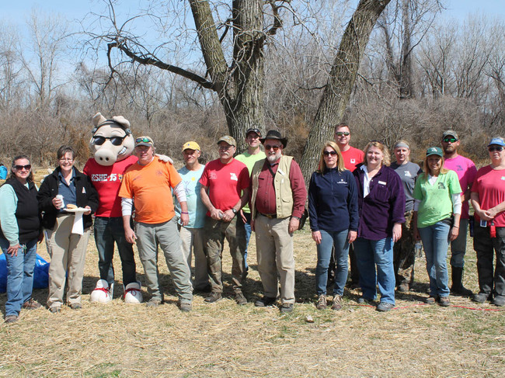
Reach
179 members
2000 Volunteers
7000 Participants
3000 email list
20-25% open rate
Facebook
849 R4R, 423 GN, 364 CTB, 107 MCS

Slide 24
Board
Charlene Waggoner, President
Greg Poleski, Vice President
Abby Broadstone, Vice President, Membership
Larry Ruff, Treasurer
Mike Claspille, Secretary
Stacie Skolodejchuk, Director
Brian Waldrop, Director
Carrie Henderson, Director
Christine Eller, Director
Sharon Kenny, Director Emeritus

Slide 25
Looking Ahead
March: Team Leader Training
March 24: Confluence Trash Bash
April 8: Mission: Clean Stream/GM Earth Day/Run for the Rivers
May : Spring Dardenne Day
August 24: Race for the Rivers
September : National Public Lands Day
October : River Ring Honeysuckle Bash
October 8: Fall Dardenne Day

Slide 26
Special Recognition: Business Partner
Big A’s
Host of the St Charles edition of the Big Muddy Speaker Series

Slide 27


Special Recognition
Kris Sorenson
Noah Wong
Board Members Past and Present
the best team in the business

Slide 28
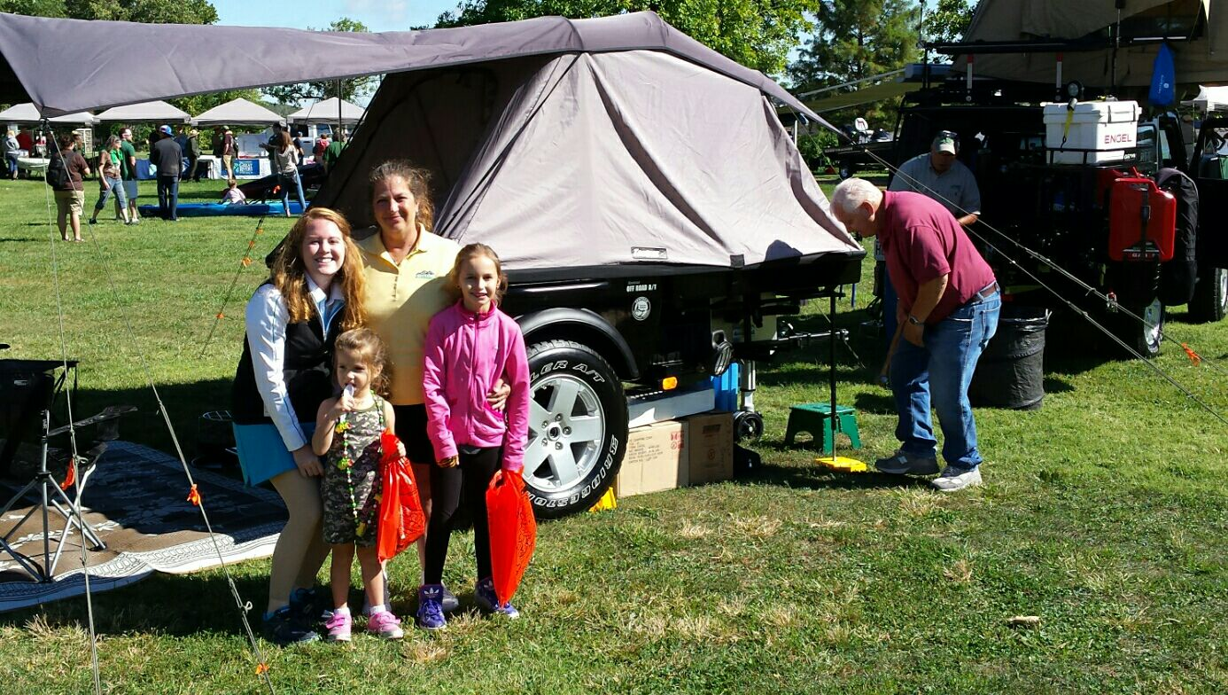
Bass Pro Shops Corporate
Outdoor Days

Slide 29
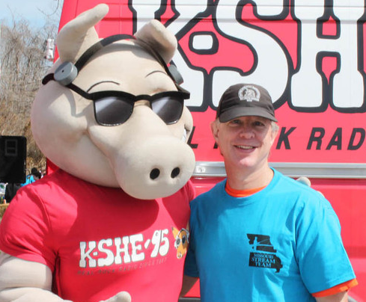
Pat Jones Volunteer 2018
Mike Claspille

Slide 30
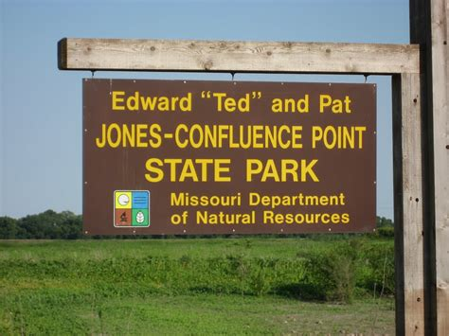
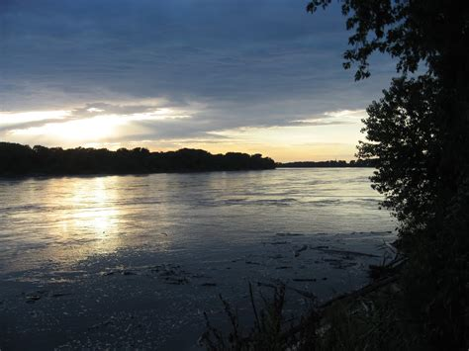
Jones Confluence Park

Slide 31
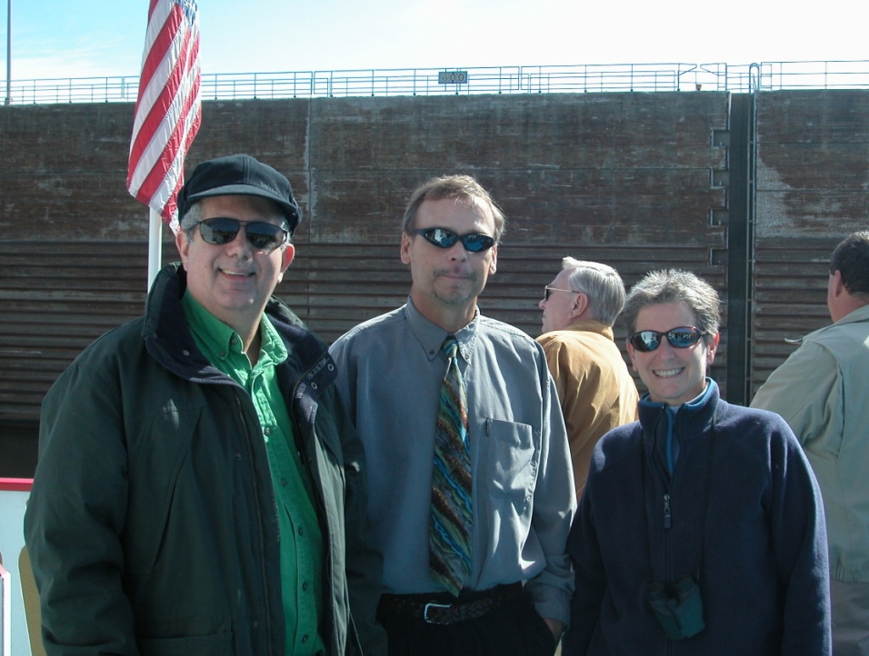
Greg Poleski

