Slide 1

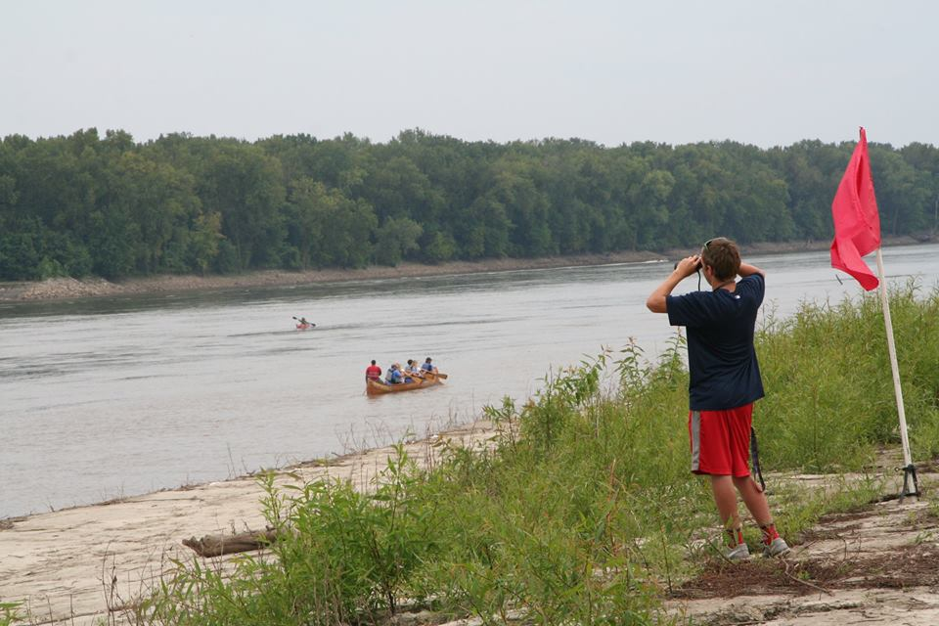
2017 Activities Report

Slide 2
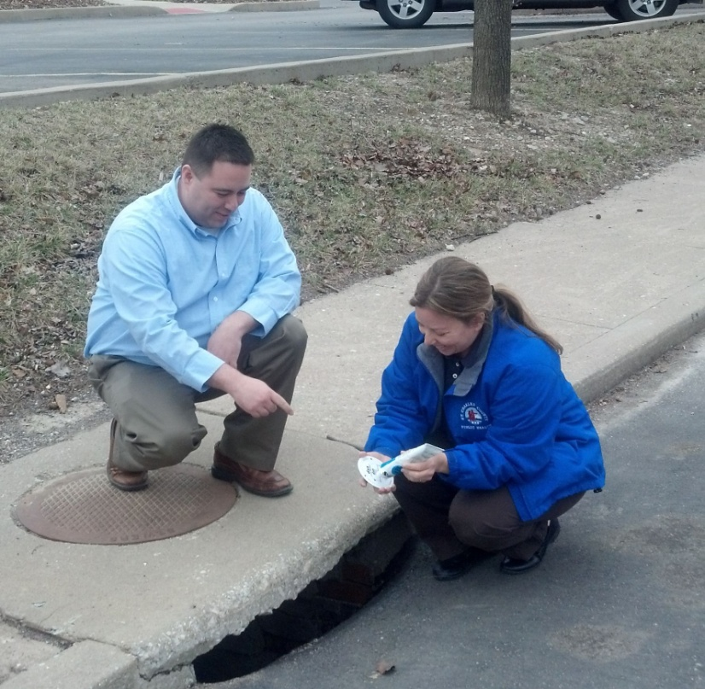
Storm Drain Marking
FINISHED!!!
Thanks to Larry Ruff and the students at St Charles Community College.
All accessible drains of the 9,000 unmarked drains in St Charles County.

Slide 3
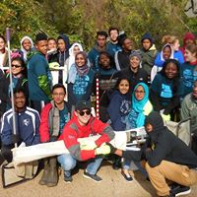

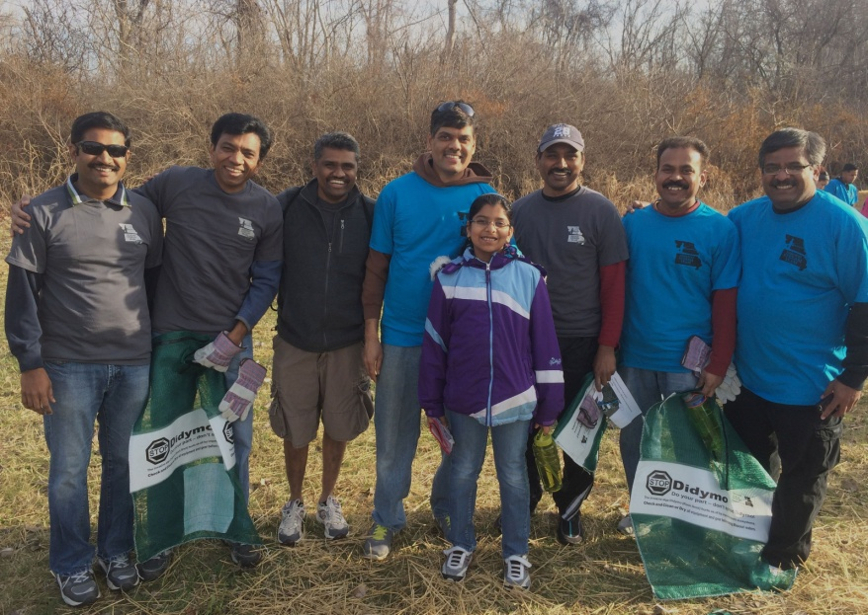
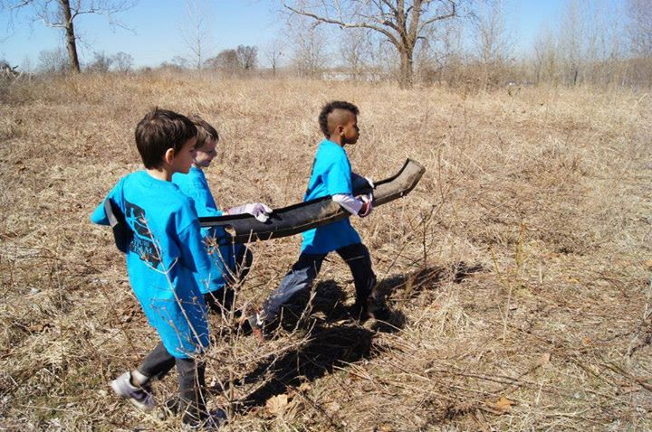
Confluence Trash Bash
Coordination
8 rendezvous locations
669 participants
15 tons of trash
300 tires
1 ton recyclables
1 ton metal

Slide 4

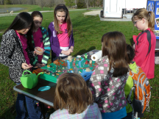
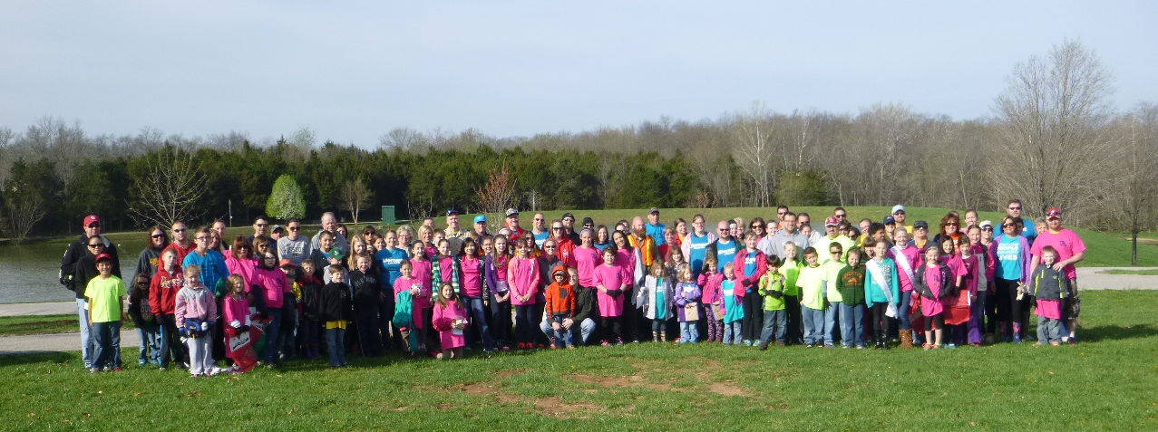
Mission: Clean Stream/GM Earth Day
1059 Volunteers staff/team leaders etc
10 tons trash
100 lbs metal
120 lbs recycling
30 tires

Slide 5
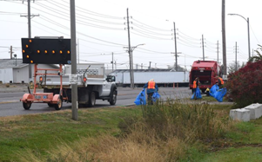
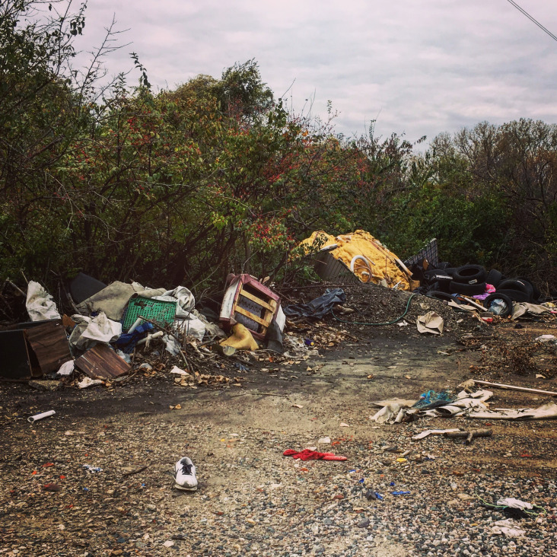
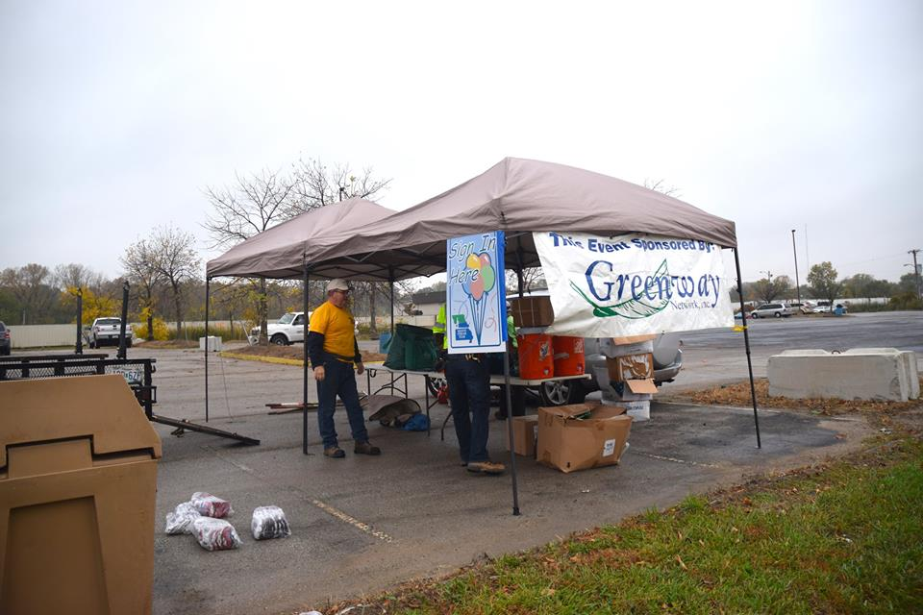
Hall Street Block Party
38 Volunteers
1.1 miles
80 cubic yards
40 tires

Slide 6
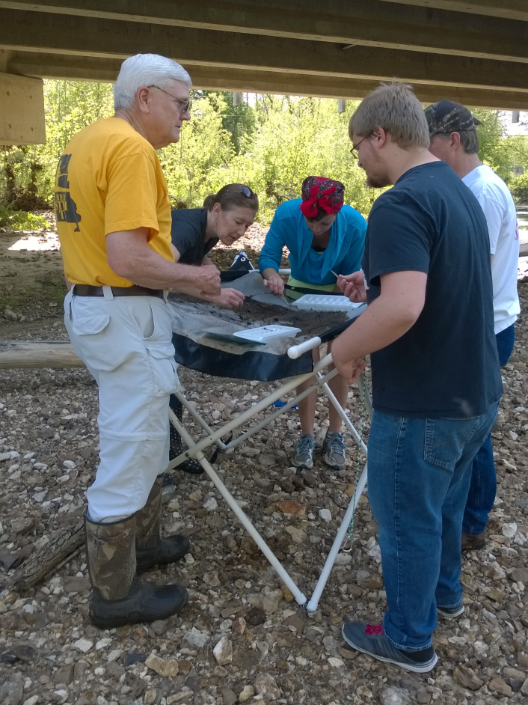
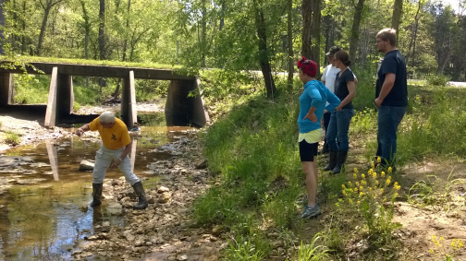
Dardenne Days
Spring and Fall
Length of stream water quality monitoring
43 volunteers
56 E.coli Tests

Slide 7
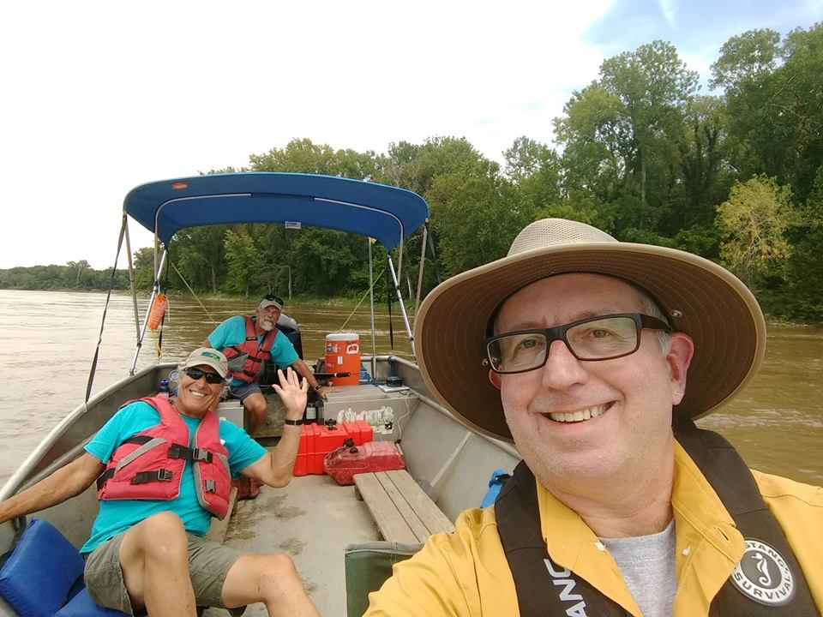
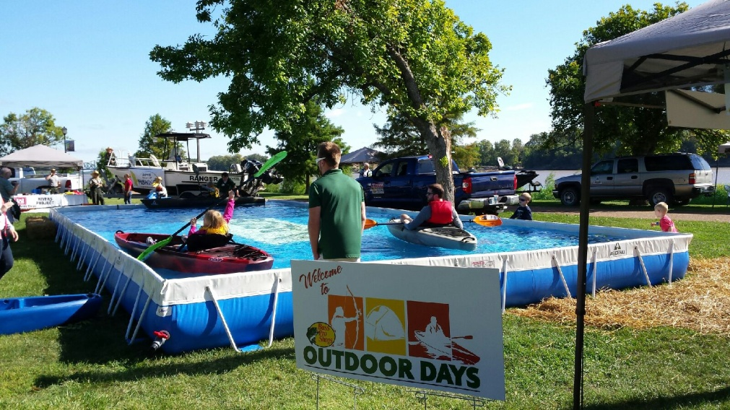
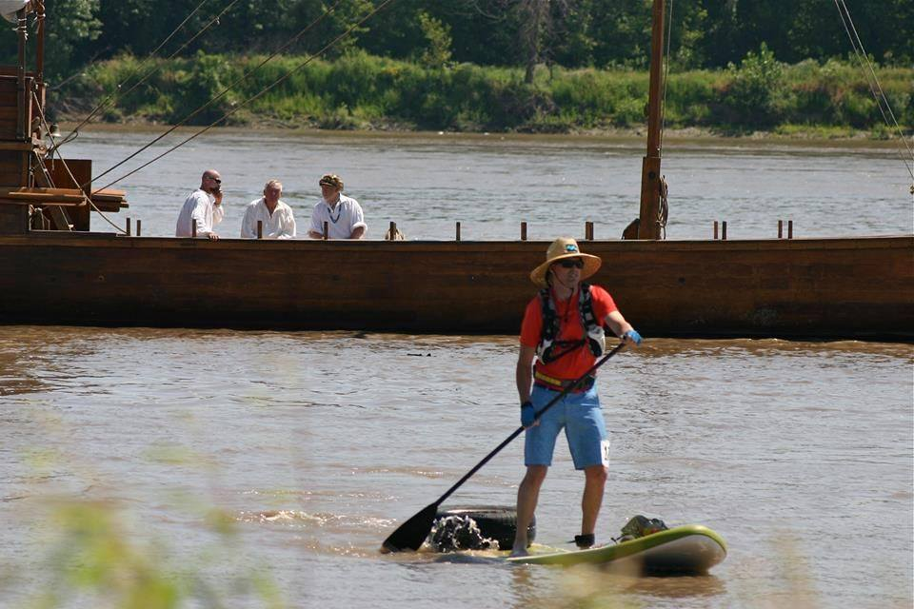
Race for the Rivers
Bass Pro Outdoor Days
132 paddlers
3500-5000 attendees
25 student volunteers
https://www.facebook.com/bpsstcharles/videos/1698208496864392/

Slide 8
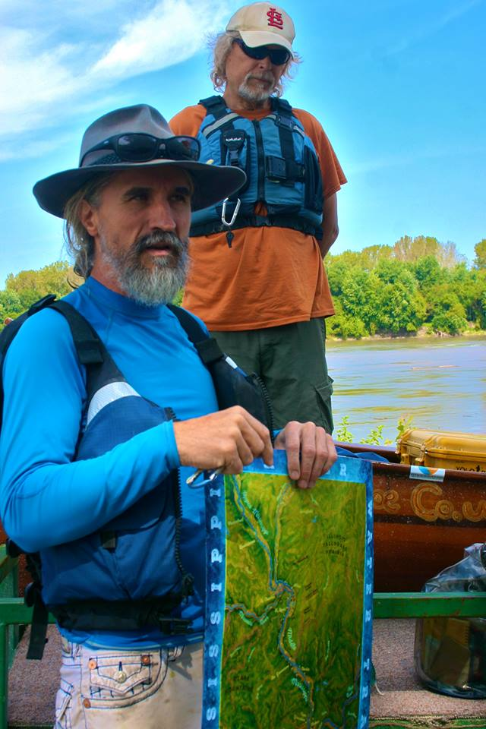
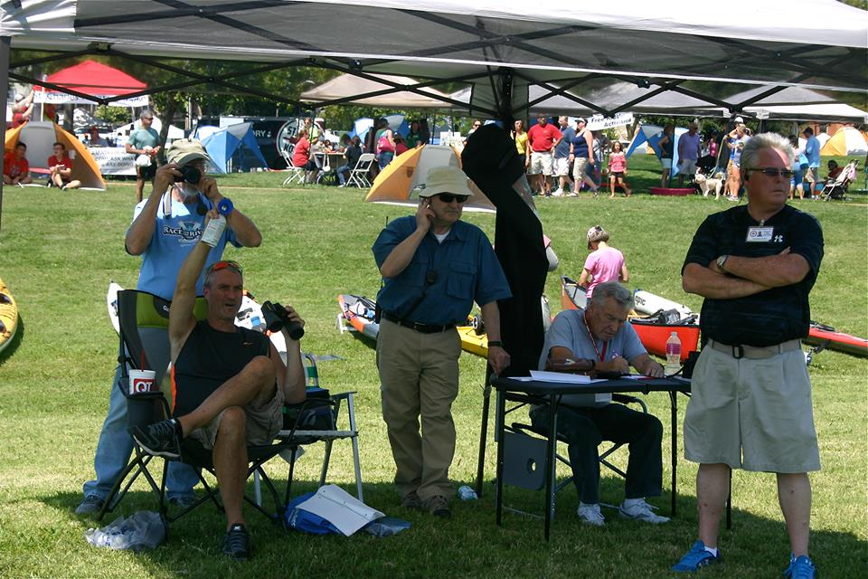
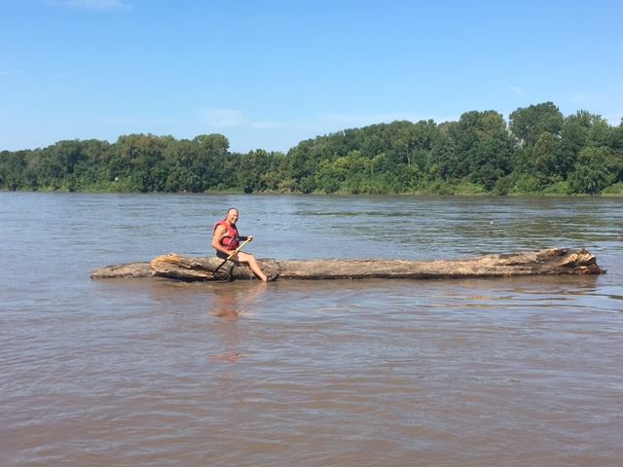

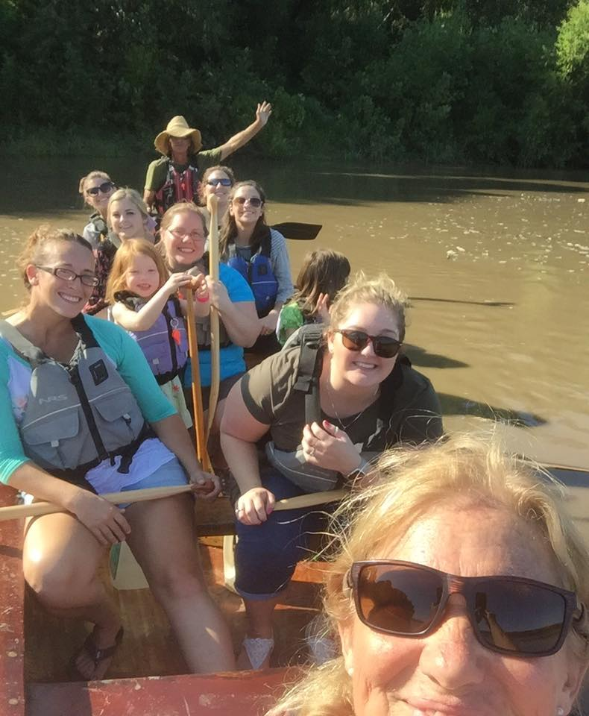
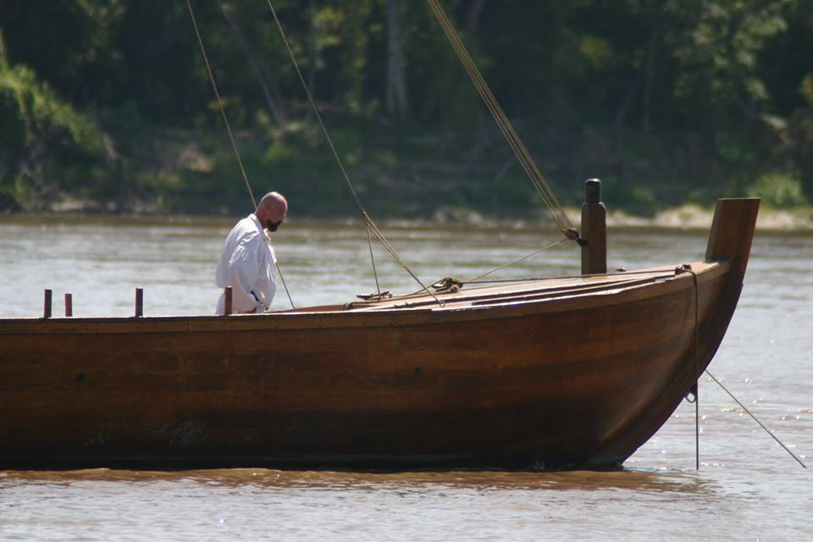


Slide 9
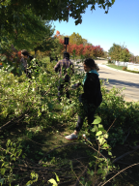
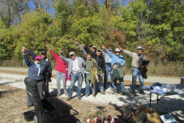
River Ring Honeysuckle Bash
Focus on Blanchette Park and Bangert Island.
52 participants
8 Student volunteers

Slide 10
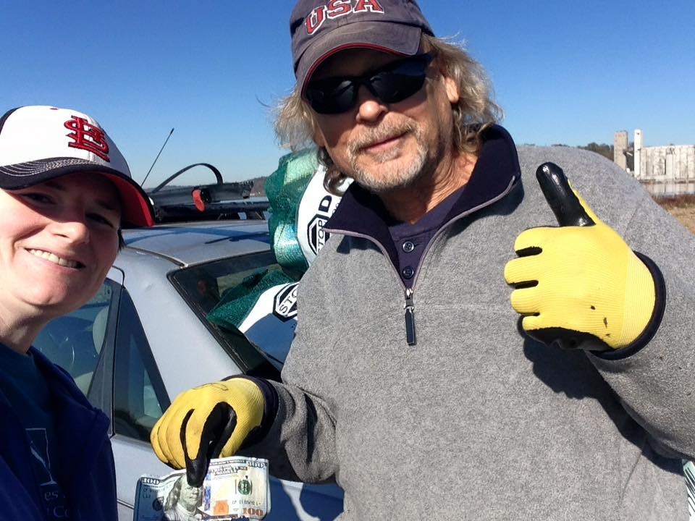
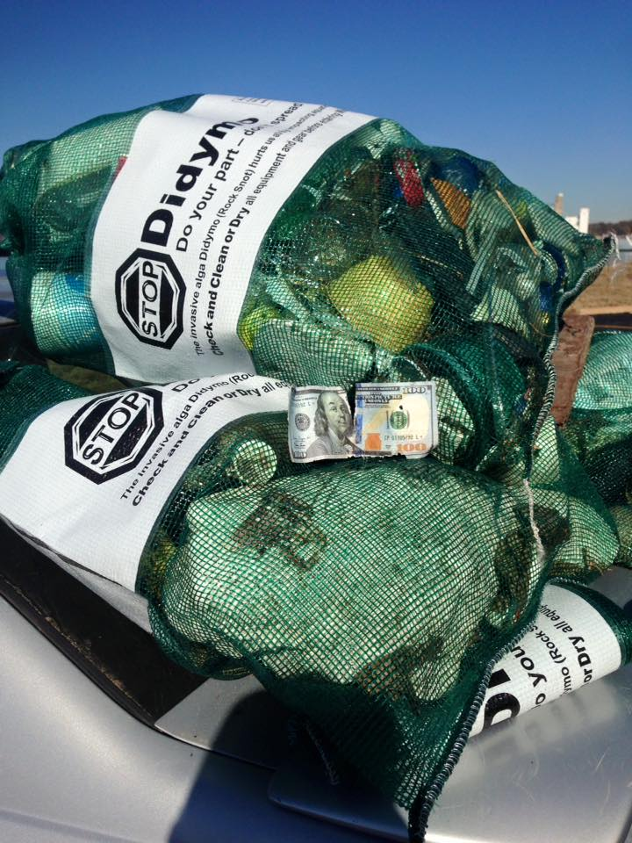
Small Group Work Days
Confluence Conservation Corps
6 clean up events
6 Honeysuckle removal events.
300 Volunteers

Slide 11
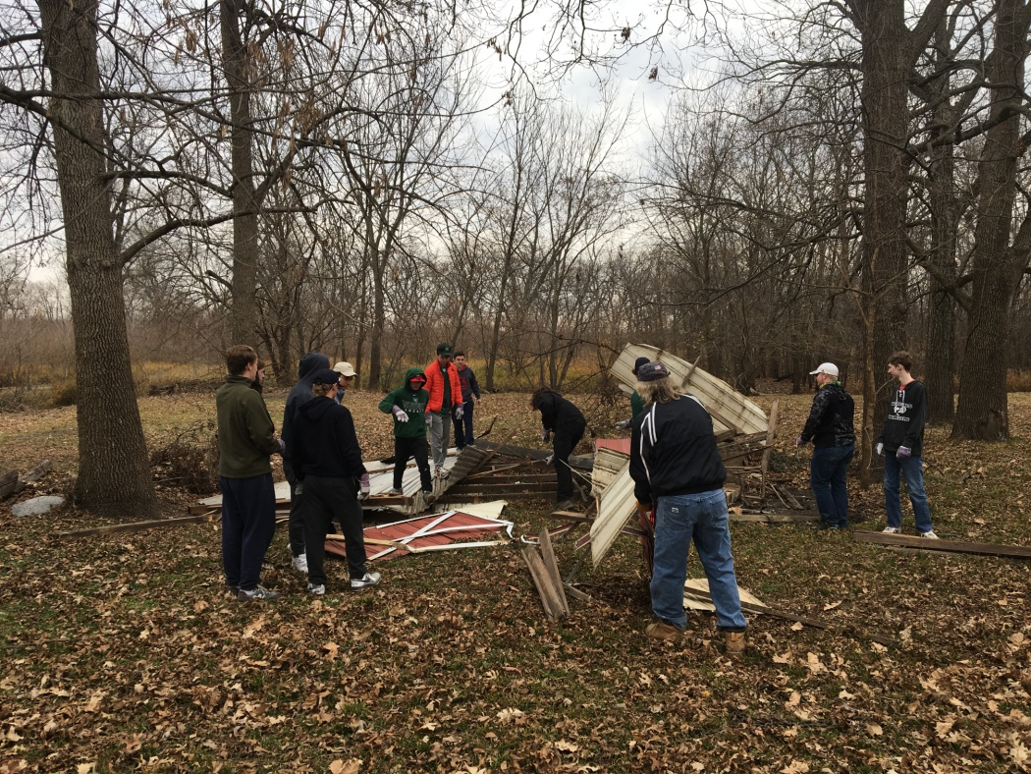
School Group Activities
Jennings Middle School
CTB
R4R
Whittfield School
Bangert Island
Portage Des Souix
Francis Howell
Lego League

Slide 12
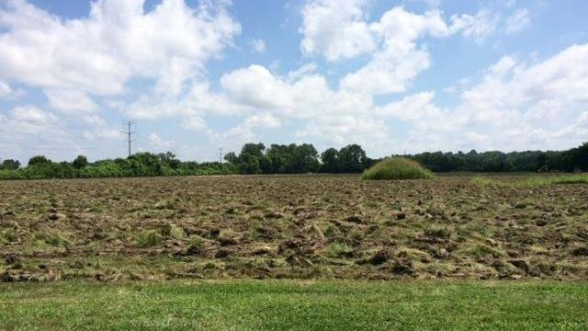
Creve Couer Park Coalition
Effective in moving ice arena out of park.
2017 Land Conservation Award

Slide 13
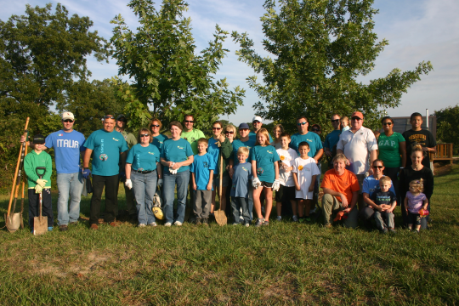
And…
Big Muddy Speaker Series
National Public Lands Day at the Confluence
100+ volunteers
River Soundings
Pelican Day
Life Outside Festival
Washington Riverfest

Slide 14
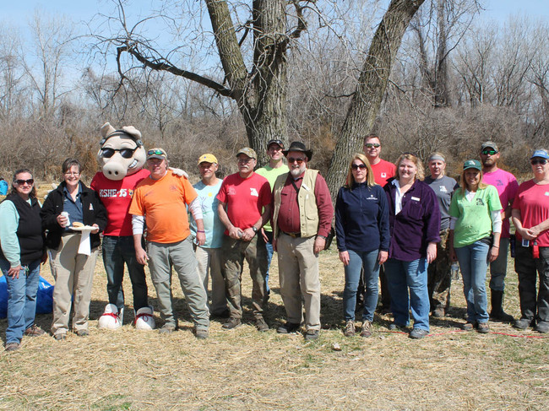
Reach
179 members
2000 Volunteers
7000 Participants
3000 email list
450 – 550 opens
Facebook
800 likes on R4R 370 GN

Slide 15
Looking Ahead 25 Year Celebration!
March 5: Special Handling Certification
March 24: Confluence Trash Bash
April 8: Mission: Clean Stream/GM Earth Day/Run for the Rivers
May : Spring Dardenne Day
August 25: Race for the Rivers
September : National Public Lands Day
October : River Ring Honeysuckle Bash
October 8: Fall Dardenne Day

