Slide 1

Annual Meeting
December 5, 2016

Slide 2
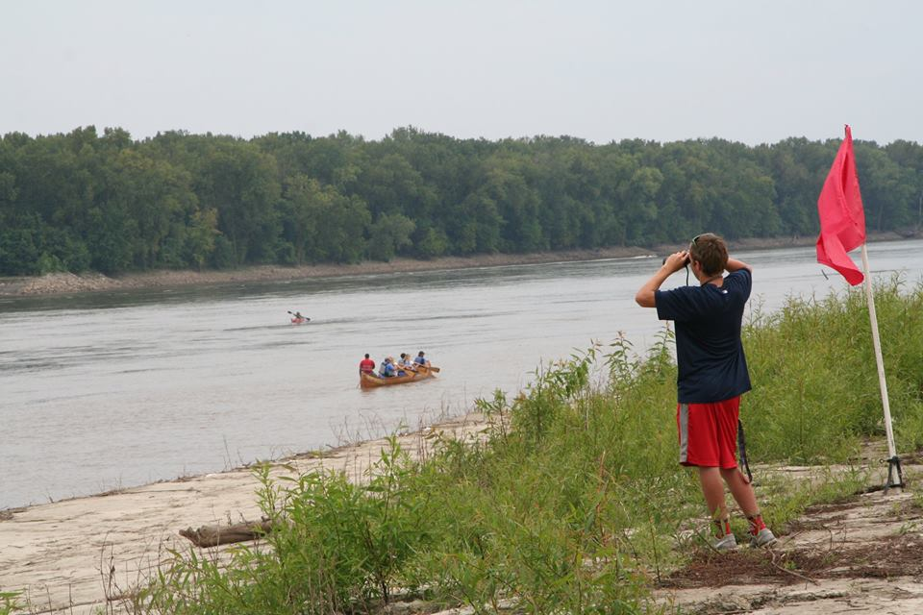
2016 Annual Report
Awards
Election of Officers

Slide 3
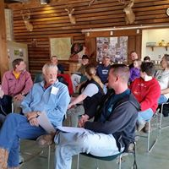
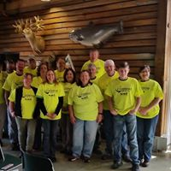
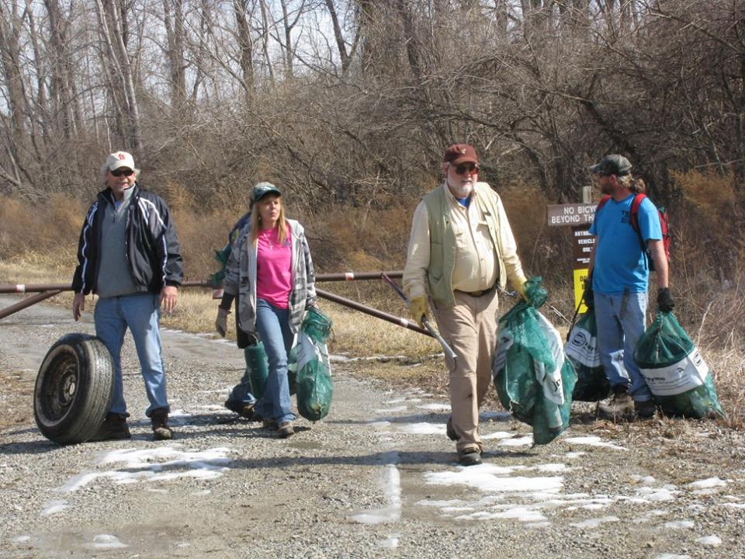
Team Leader Training
Recruiting
Safety
Clean up

Slide 4
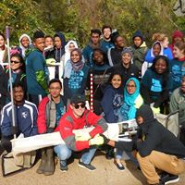

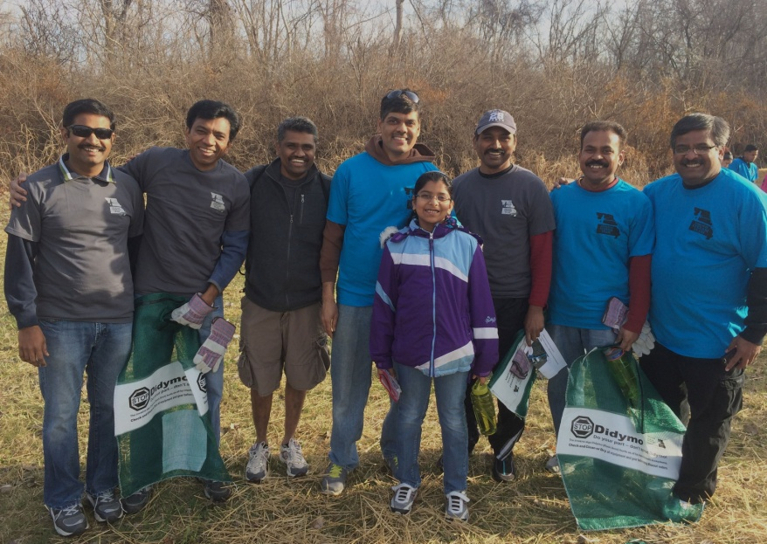
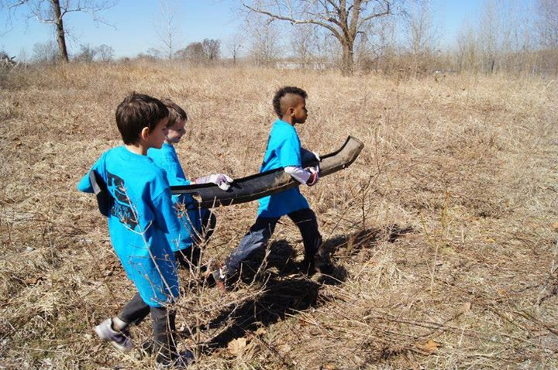
Confluence Trash Bash
Coordination
9 rendezvous locations
524 participants
6.12 tons of trash
381 tires
1 ton recyclables

Slide 5
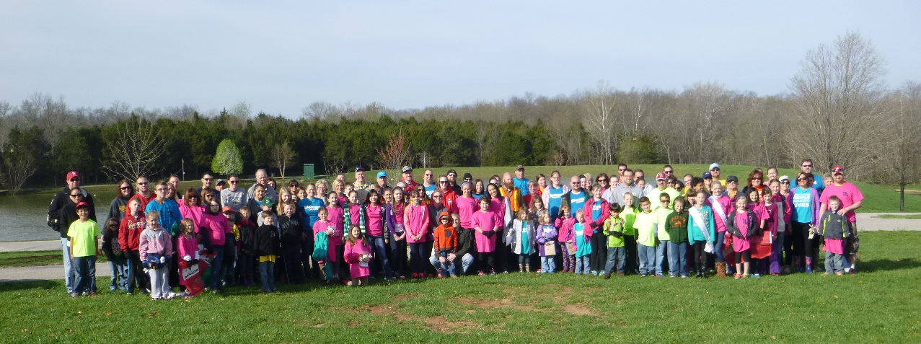
Mission: Clean Stream
960 participants
5.5 tons trash
11* tires

Slide 6

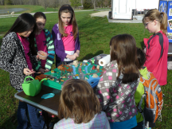
GM Earth Day
Rotary Park
200-300participants
New vendors
Food and music

Slide 7
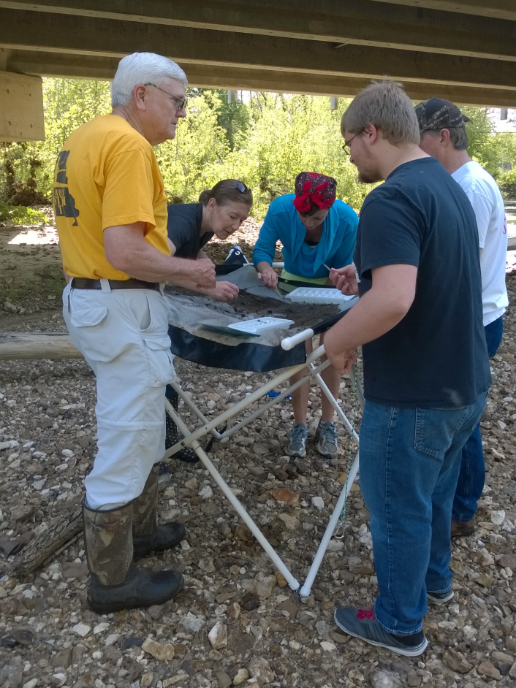
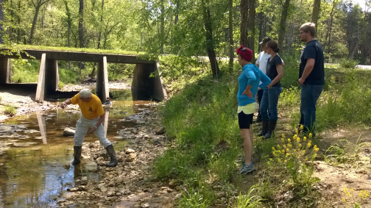
Dardenne Days
Spring and Fall
Length of stream water quality monitoring
40 volunteers

Slide 8
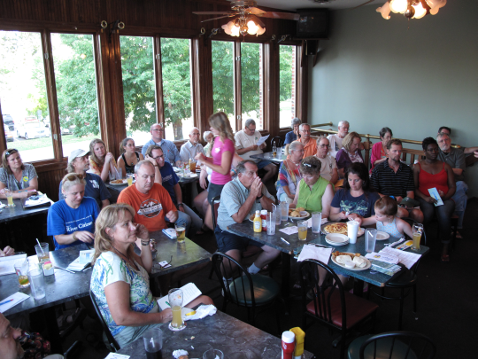
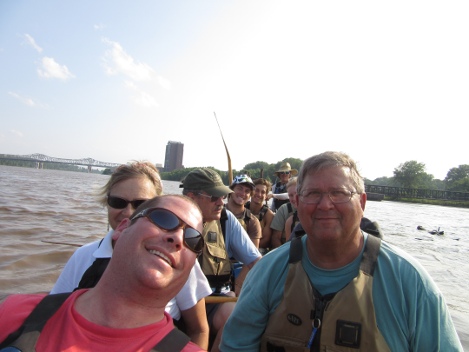
Big Muddy Speaker Series
11 presentations
In support of the Big Muddy Refuge in cooperation with Missouri River Relief

Slide 9
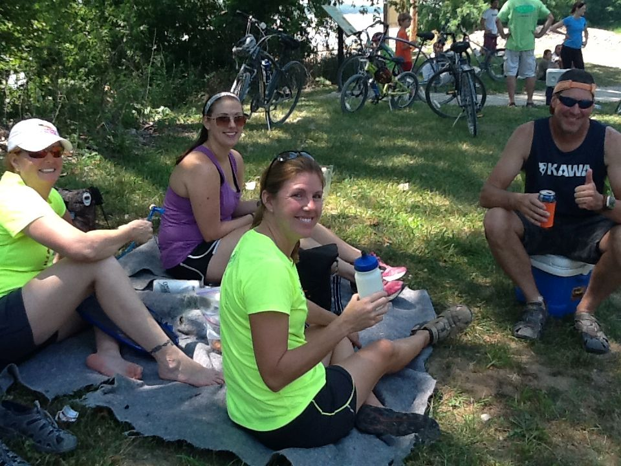
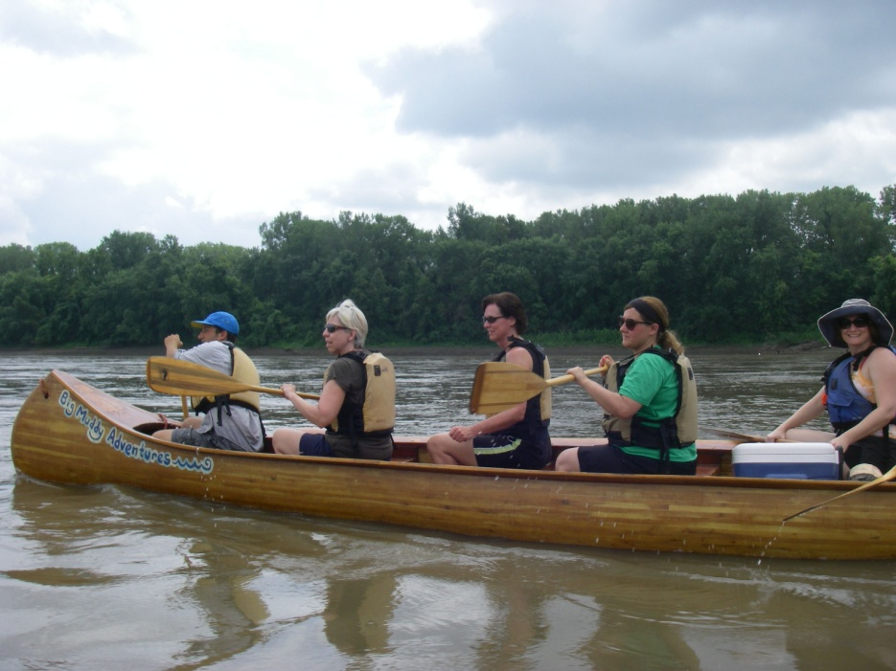
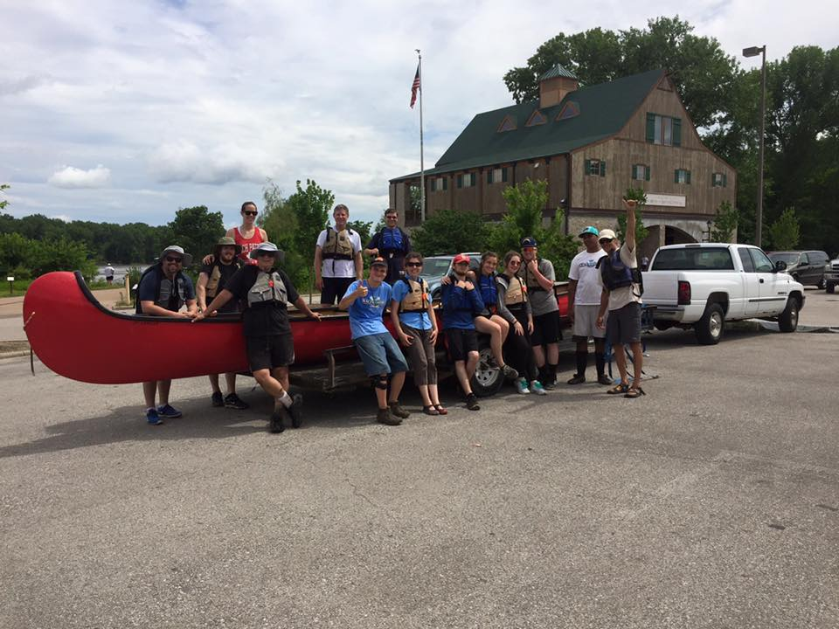
Pedal and Paddle Events
4 Events
GRG
Katy Trail Bikes
Bike Stop Café
Big Muddy Adventures

Slide 10
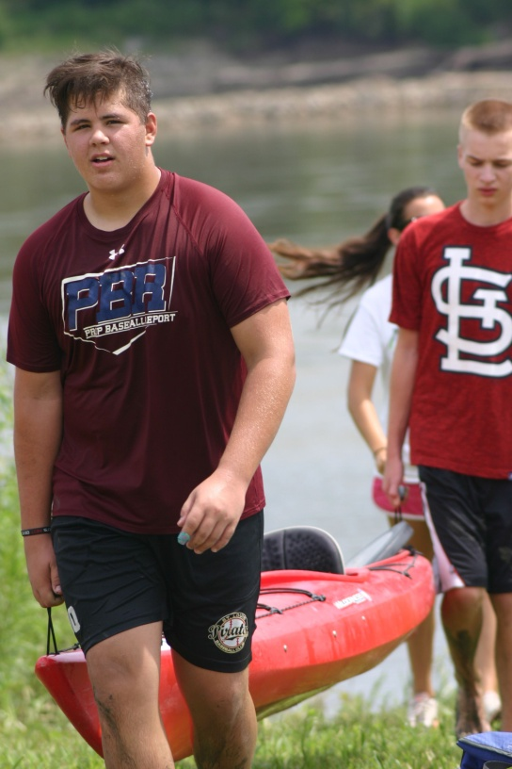

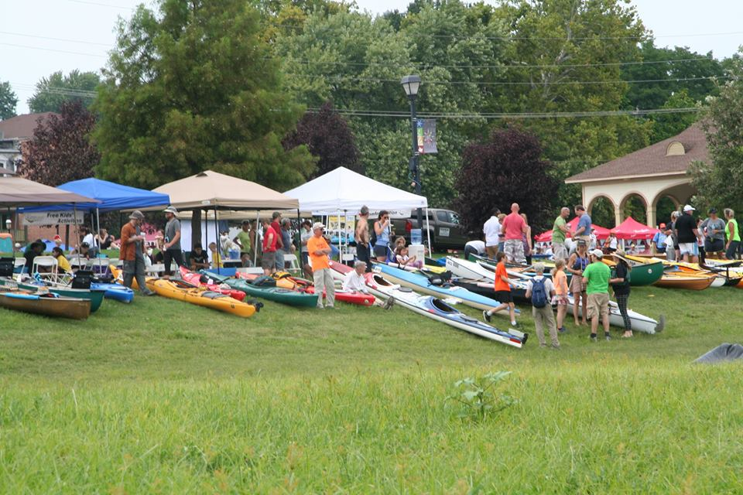
Race for the Rivers
110* paddlers
New Marketing
2000 attendees
River education

Slide 11
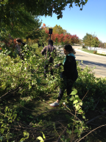
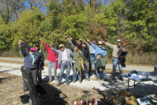
River Ring Honeysuckle Bash
New event created at the request of Great Rivers Greenway
Four sites including organizations and municipalities from St Louis/St Louis County and St Charles County
52 participants

Slide 12
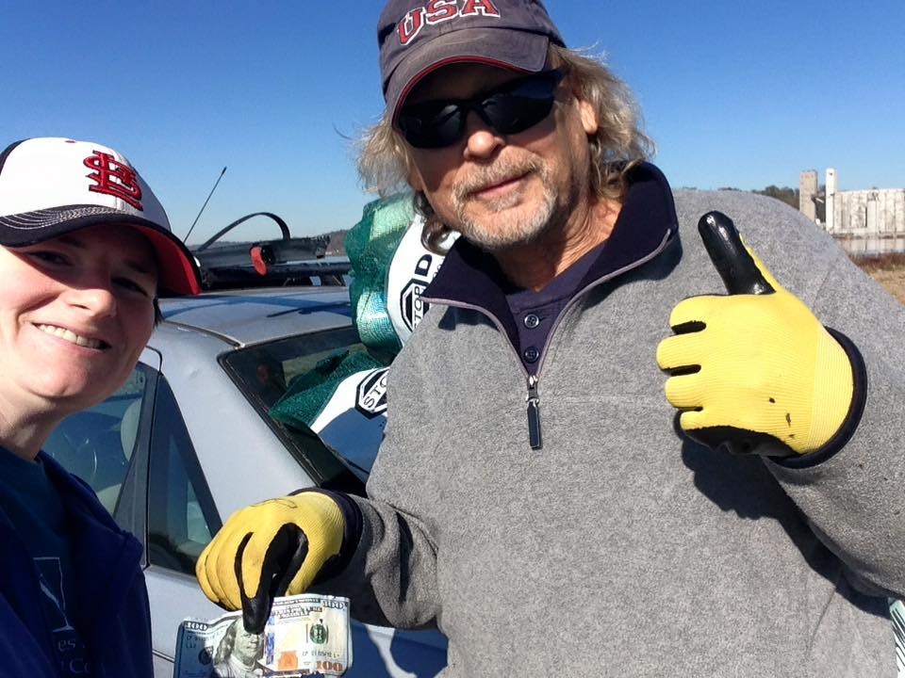
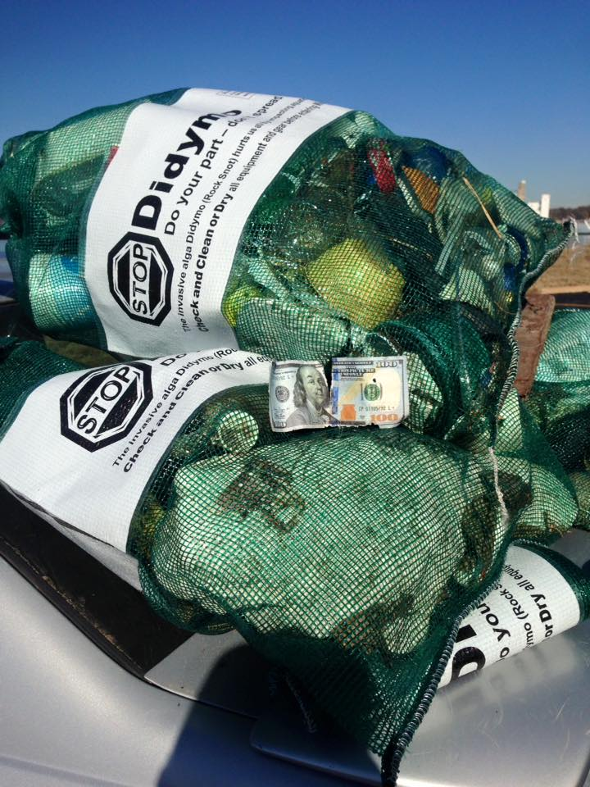
Confluence Conservation Corps
Second Sunday
Welcome Sarah Wright Aholt and Carrie Henderson to the organizing committee

Slide 13
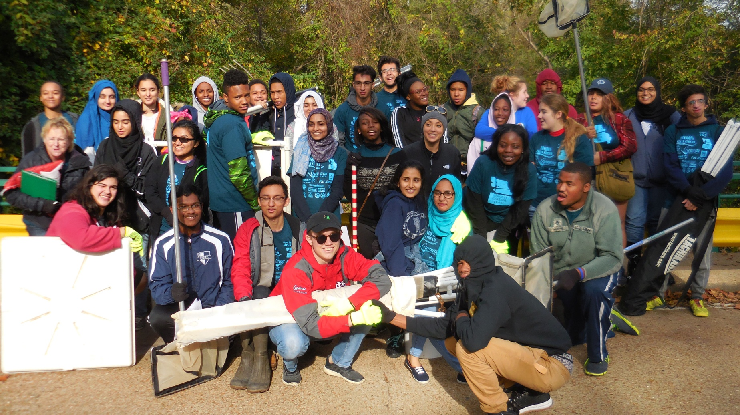
Creek Monitoring
St Louis Public Collegiate School

Slide 14
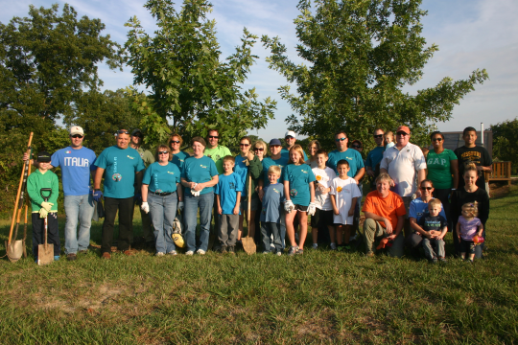
And…
National Trails Day
National Public Lands Day at the Confluence
Earth Day St Louis
Storm Drain Marking
St Charles OutDoor Days
Life Outside Festival

Slide 15
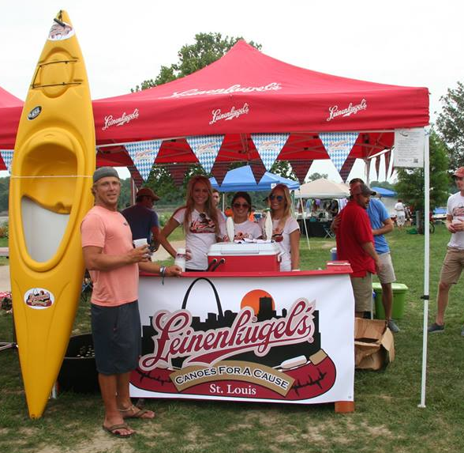
Sponsors
Great Rivers Greenway
Mrs Pat Jones
Thought Process Interactive
Missouri American Water
GM Wentzville
Metropolitan Sewer District
Walmart – Wentzville
Leinenkugel
Sams Club – Wentzville

Slide 16
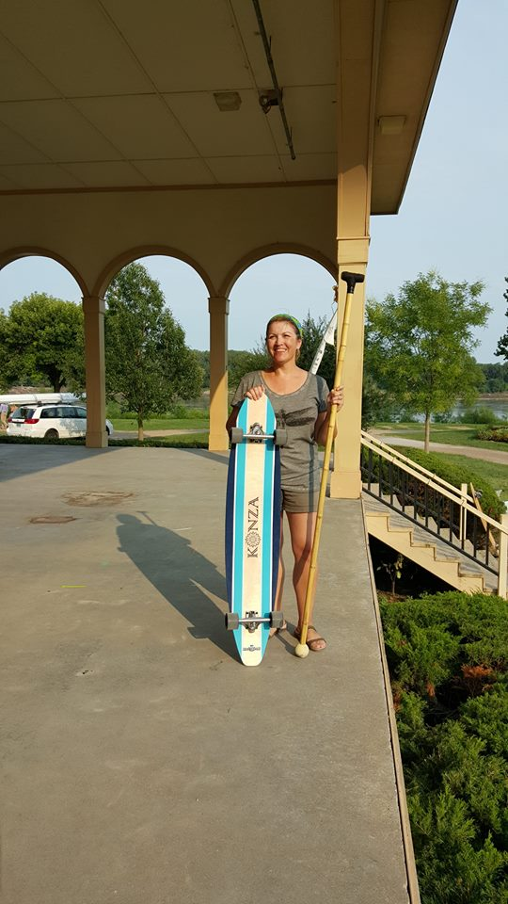
Sponsors (Cont)
J&M Family Enterprises
SCI Engineering
Mitchell James Salon
Talbot’s Frontenac
Alpine Shop
Ms Judy Mulholland
Ladsurfski

Slide 17
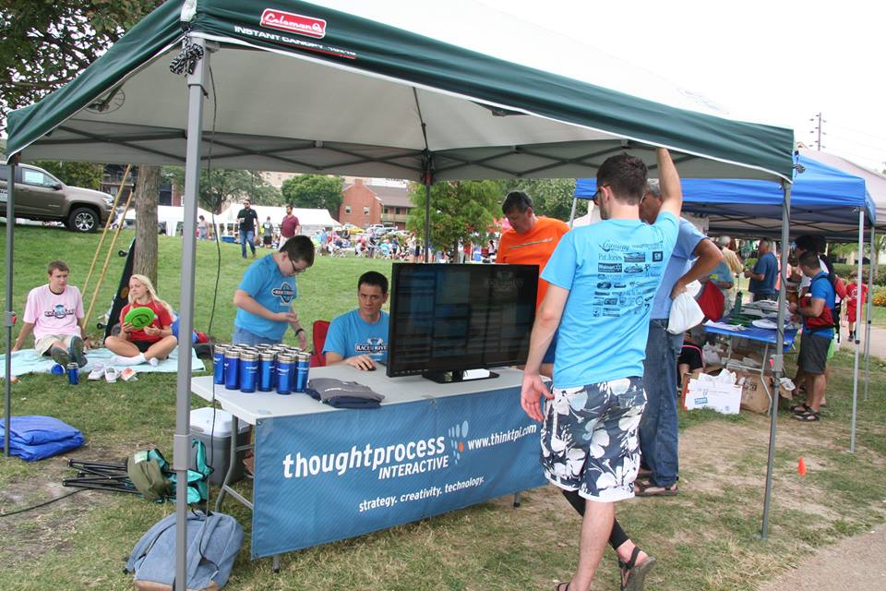
Generous Assistance Provided by
Big Muddy Adventures
St Louis Audubon
Revolution Cycles
Bike Stop Café
Katy Trail Bike Shop
Living History Company
Old First Capitol State Park
Missouri Master Naturalists
Cities of Wentzville, Dardenne Prairie, Cottleville, St Charles, O’Fallon, St Louis, Bridgeton, Overton, Maryland Heights, Florrisant and St Louis County.
Missouri Department of Conservation
Missouri Stream Team. Stream Team Together, League of Watershed Gardians and the Mighty 211

Slide 18
Financial Report
Year To Date:
Income $31,665.24
Expenditures $44,487.23
-12,864.03
Cash in Bank $52,987.83
Restricted Funds $ 2,328.89

Slide 19
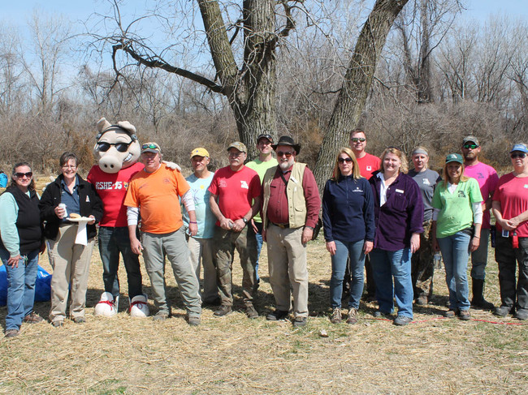
Reach
179 members
1800 Volunteers
4000+ Participants

Slide 20
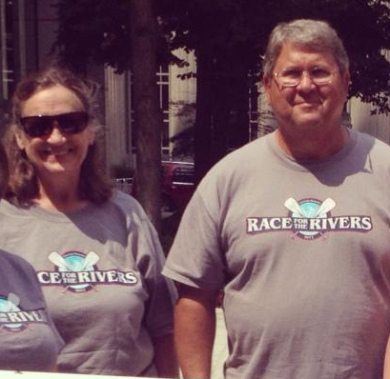
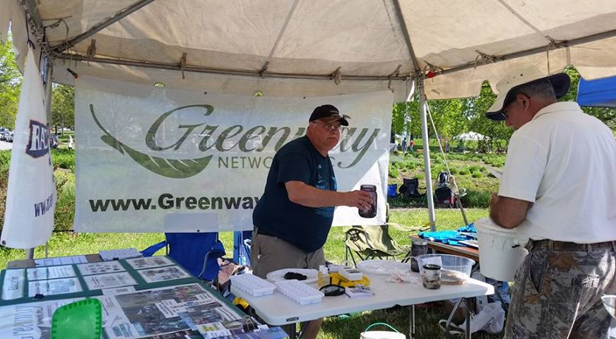
Many Thanks and Best Wishes
Retiring Board Members
  Mike Garvey
  David Hartman, Secretary

Slide 21
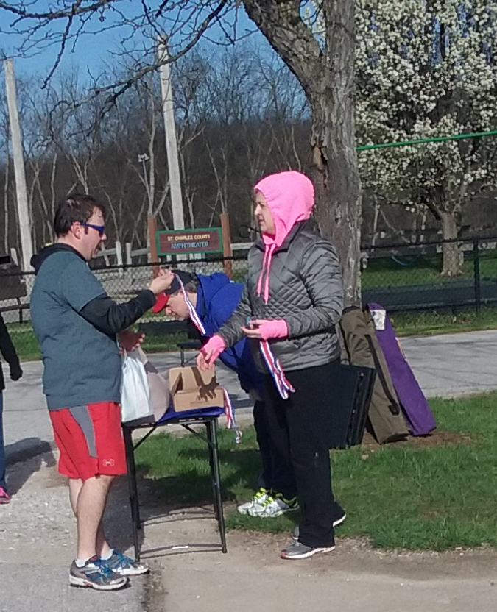
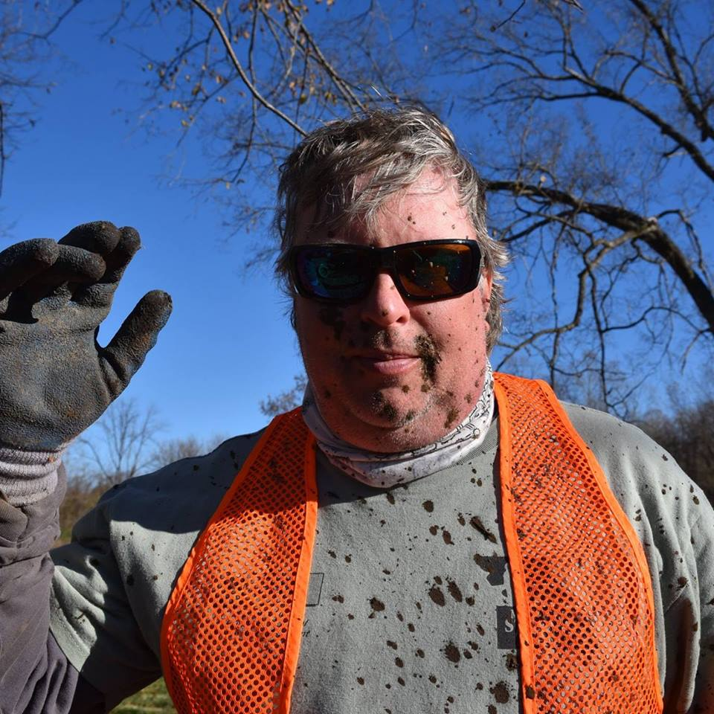
Welcome New Board Members
Stacie Schelski Brian Waldrop

Slide 22
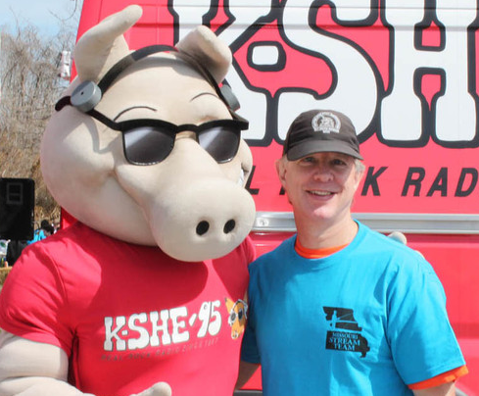
Board
Charlene Waggoner, President
Greg Poleski, Vice President
Abby Broadstone, Vice President, Membership
Larry Ruff, Treasurer
Mike Claspille, Secretary
Jessica Rowe, Historian
Stacie Schelski, Director
Sharon Kenny, Director
Brian Waldrup, Director

Slide 23
Looking Ahead
February 22: River Soundings Series Flood Plain Issues
March 5: Team Leader Training
March 18: Confluence Trash Bash
April 1: Mission: Clean Stream/GM Earth Day/Run for the Rivers
May 7: Spring Dardenne Day
June 3: National Trails Day
August 26: Race for the Rivers
September 30: National Public Lands Day
October 7: River Ring Honeysuckle Bash
October 8: Fall Dardenne Day

Slide 24
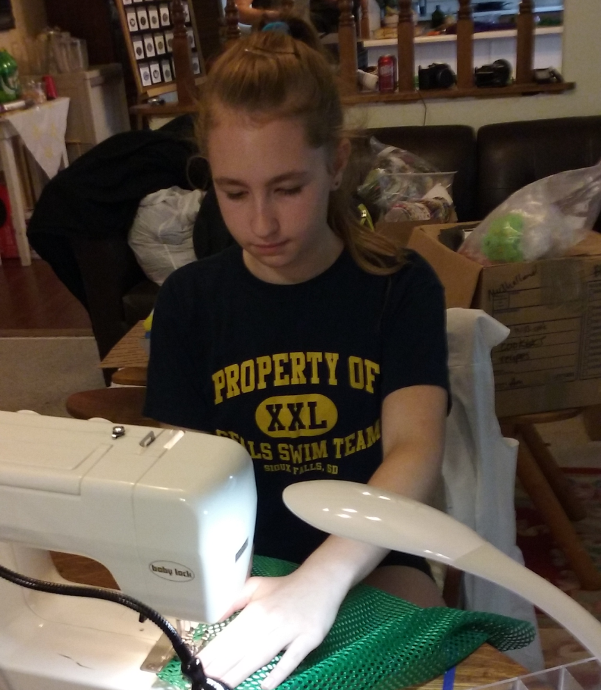
Special Recognition
Bangert Island Exploration Preparation
Angi Sorensen
Rhiannon Sorensen
Bev Wraspir

Slide 25
Special Recognition: Business Partner
Big A’s
Host of the St Charles edition of the Big Muddy Speaker Series

Slide 26
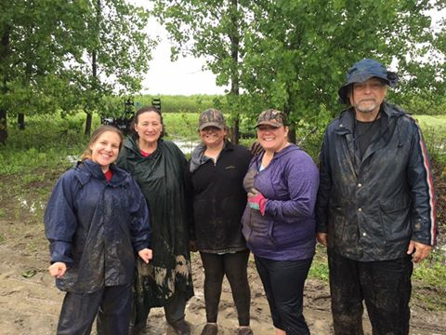
Special Recognition: Agency
Quinn Kellner
Jones Confluence State Park

Slide 27
Special Recognition: Volunteer
Pat Routh
Forrest Routh
Race for the Rivers 10 years of service.

Slide 28
Pat Jones Volunteer 2016
Sharon Kenny

