Slide 1

Annual Meeting
December 8, 2015

Slide 2
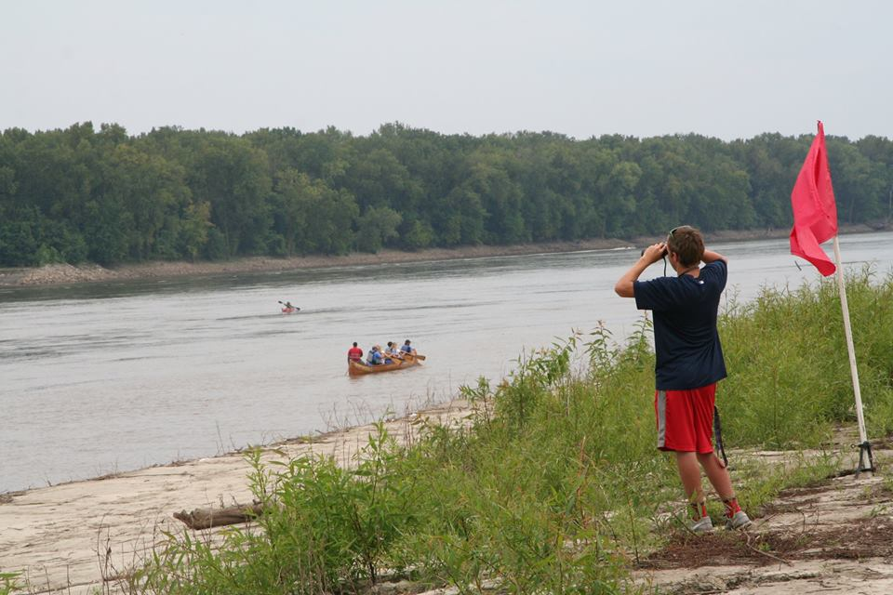
2015 Annual Report
Awards
Election of Officers

Slide 3
Mission Statement
Our Mission is to conserve natural resources, encourage sound management of the watersheds, and protect the quality of life for the residents of the St. Louis Region. We do that by creating a network of communication and consensus among citizens, government leaders and other organizations which share our goals. Most of all, we encourage everyone to 'act locally' to make it happen.

Slide 4
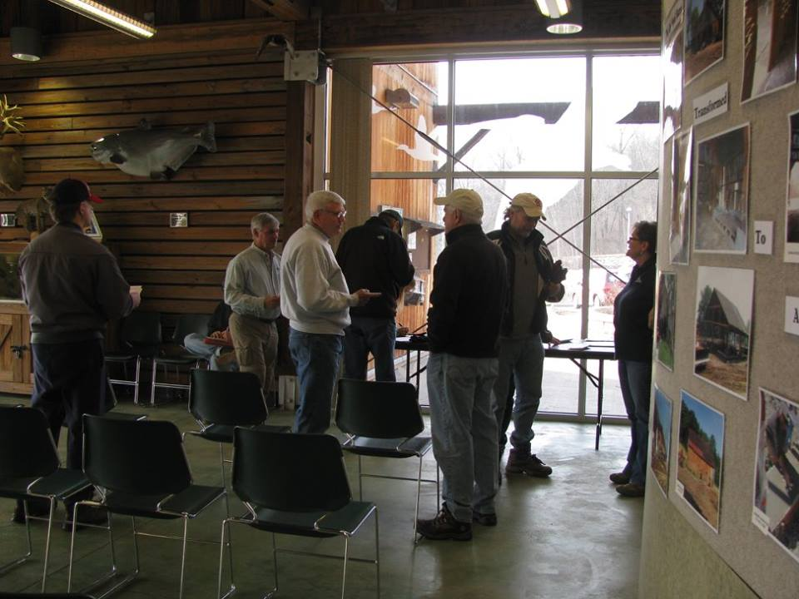
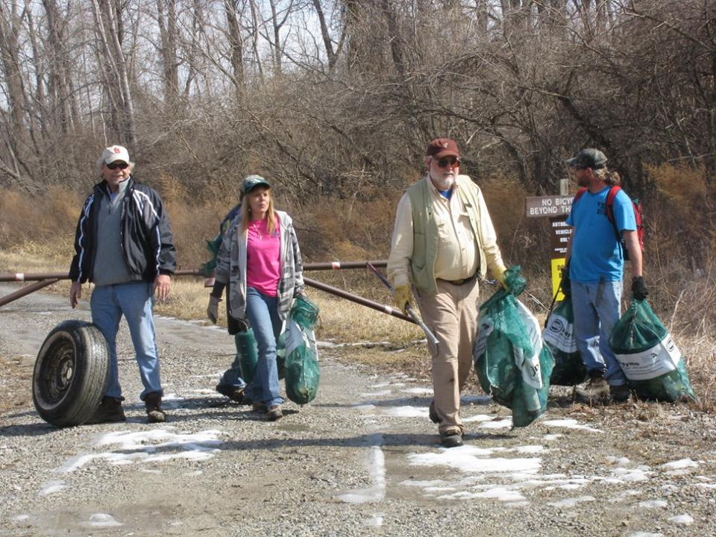
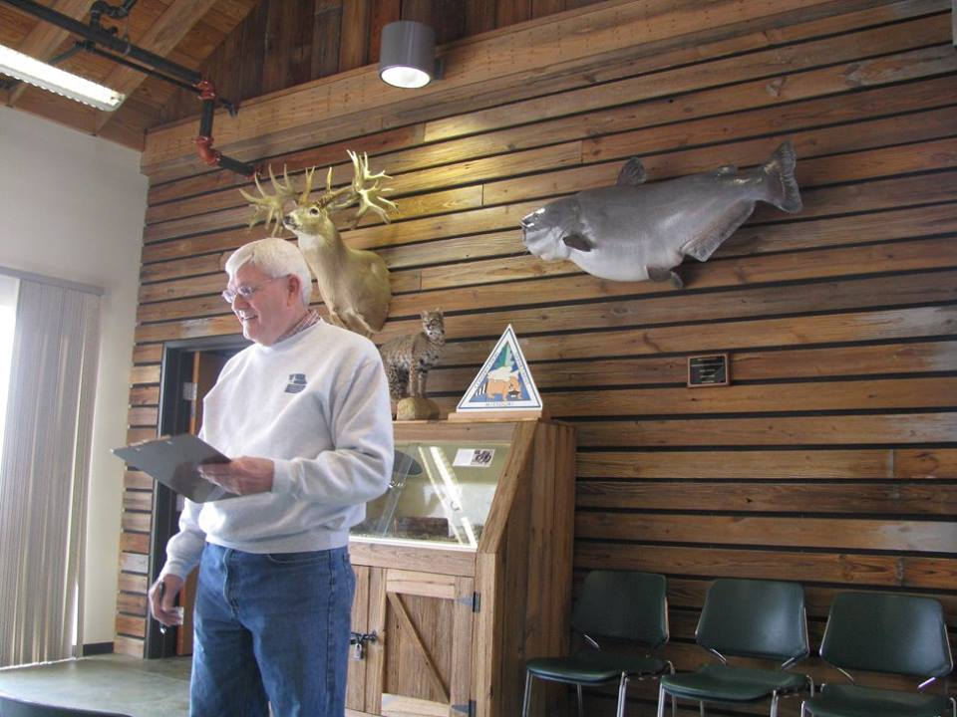
Team Leader Training
Recruiting
Safety
Clean up
Honeysuckle removal

Slide 5
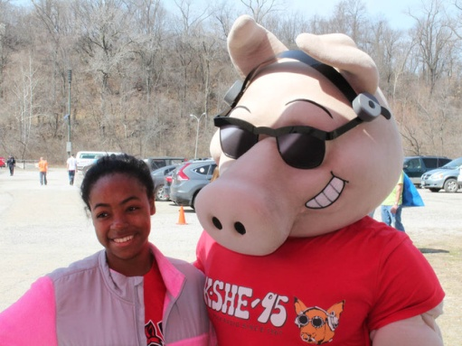

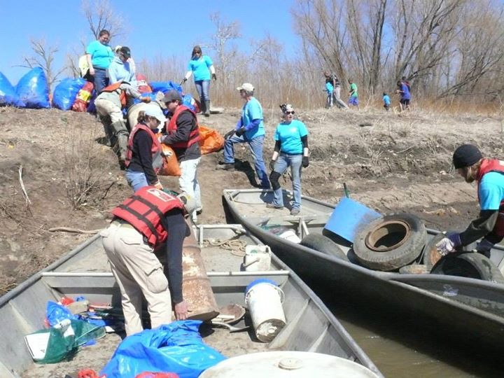
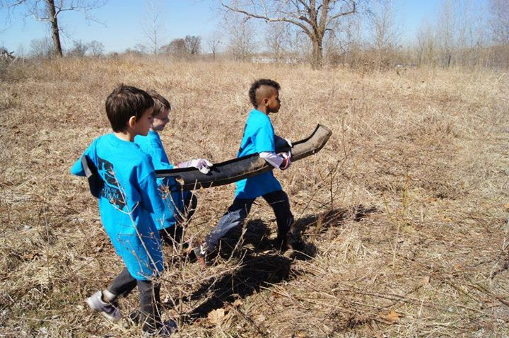
Confluence Trash Bash
Coordination
Added sites
Enhanced Marketing
6 rendezvous locations
606 participants
13 tons of trash
400+ tires

Slide 6
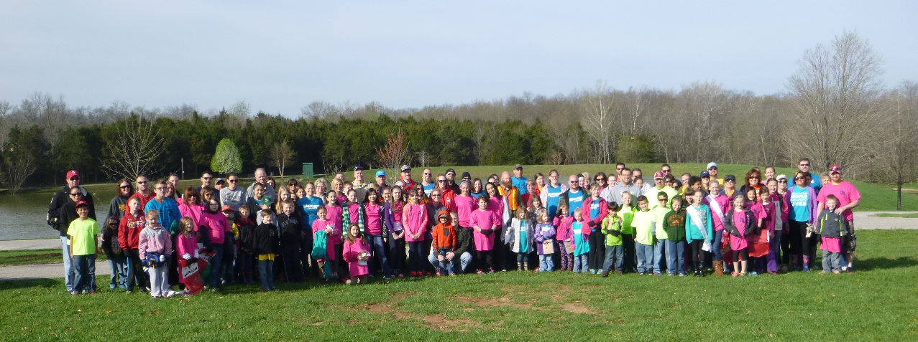
Mission: Clean Stream
836 participants
7 tons trash
46 tires

Slide 7
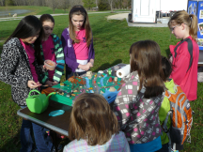
GM Earth Day
Rotary Park
400- 500 participants
New vendors
Food and music
Better Participation than ever
(adding a 5K run for 2016)

Slide 8
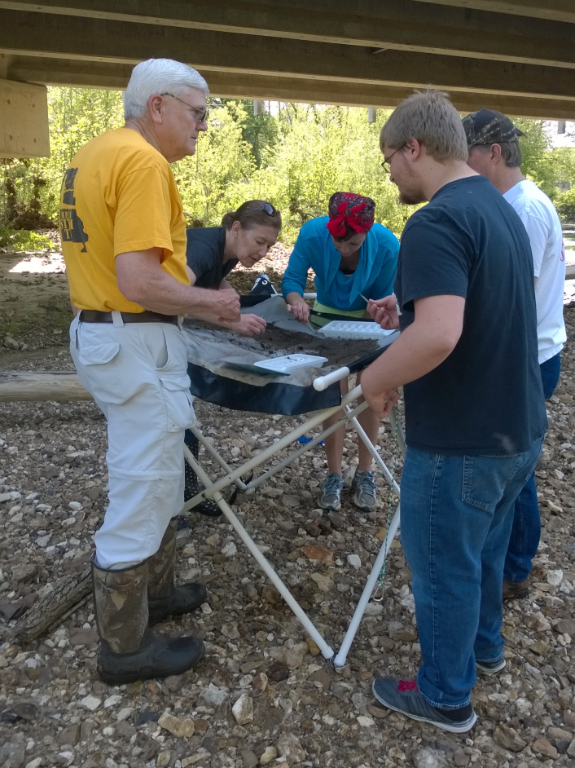
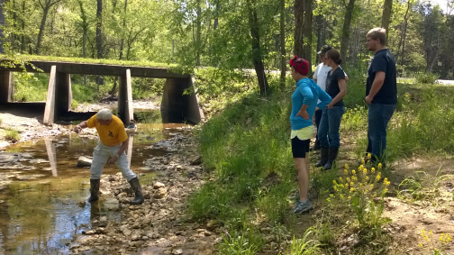
Dardenne Days
Spring and Fall
Length of stream water quality monitoring
53 volunteers

Slide 9
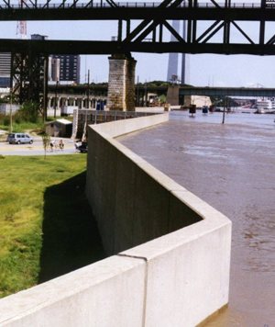
National Adaptation Forum
Pre Forum
Bringing the conversation about adaptation to the local level with concrete discussions about options and opportunities.

Slide 10
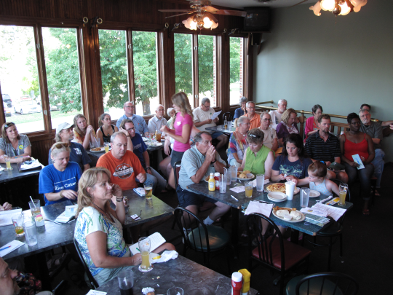
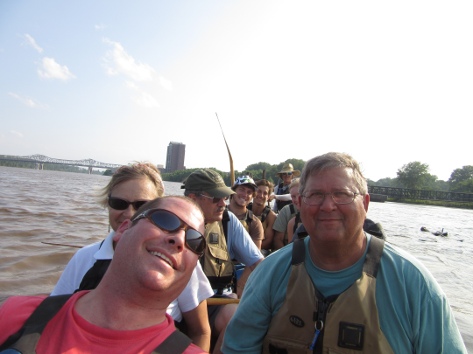
Big Muddy Speaker Series
11 presentations
Paddle the Missouri River with Big Muddy Adventures weather permitting.
In support of the Big Muddy Refuge in cooperation with Missouri River Relief

Slide 11
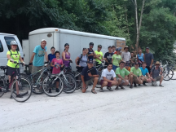
Pedal and Paddle Events
5 Events
Added different routes and new vendors
Demonstrating the viability of this sort of tourism on the Missouri River.
“Sold” out as usual

Slide 12
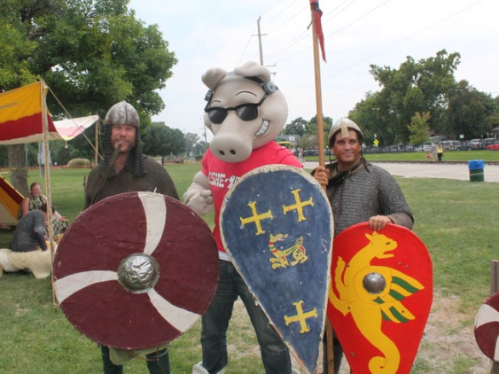
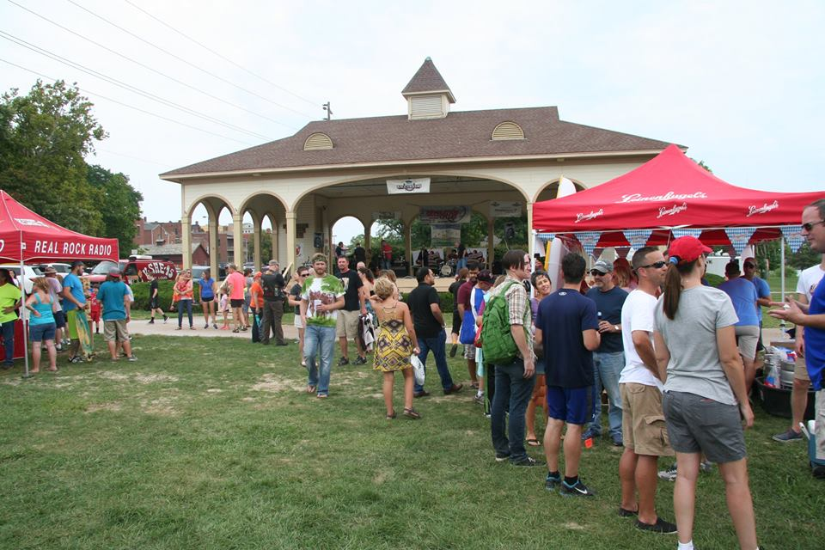
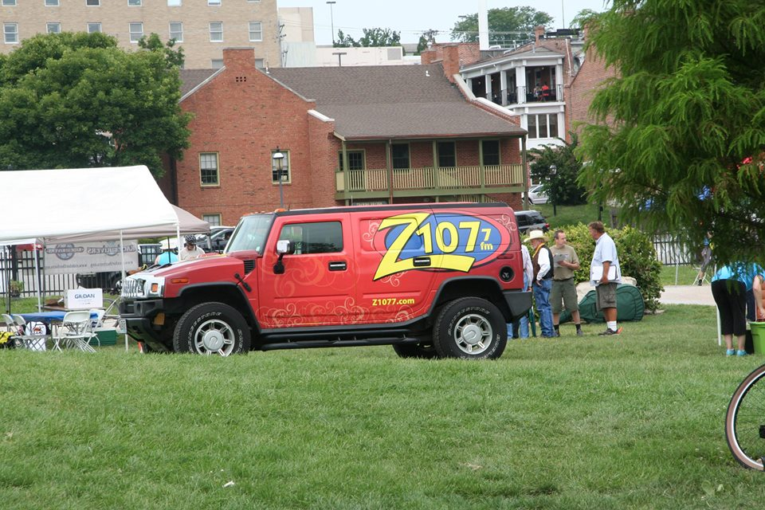
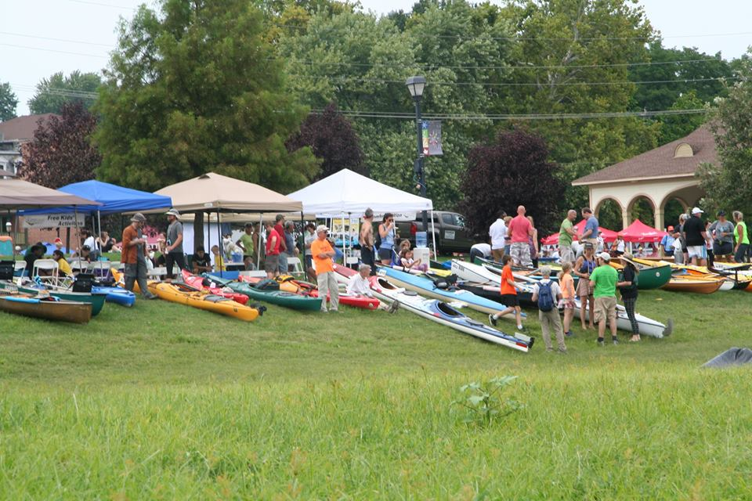
Race for the Rivers
149 paddlers
New Marketing
2500 attendees
River education

Slide 13
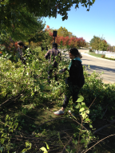
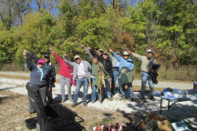
River Ring Honeysuckle Bash
New event created at the request of Great Rivers Greenway
Four sites including organizations and municipalities from St Louis/St Louis County and St Charles County
52 participants

Slide 14
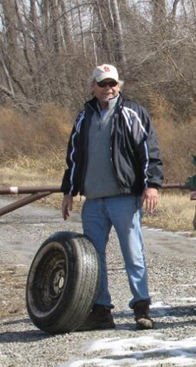
Confluence Conservation Crew

Slide 15
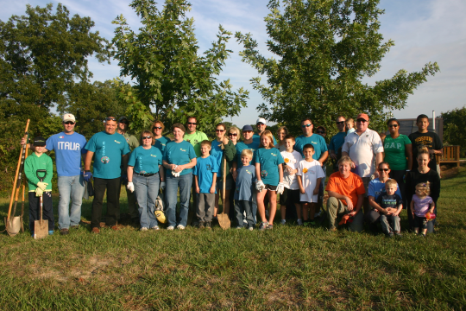
And…
National Trails Day
National Public Lands Day at the Confluence
River Soundings
Earth Day St Louis
Storm Drain Marking
  49 participants
  Estimated 6,000 drains.

Slide 16
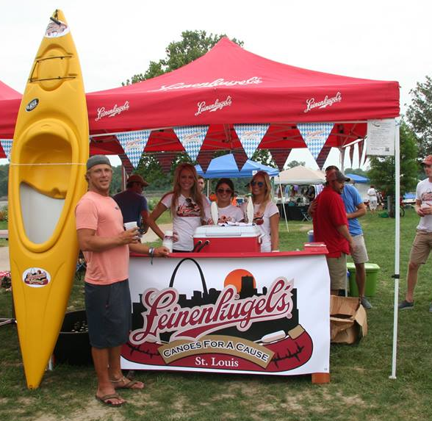
Sponsors
Great Rivers Greenway
Mrs Pat Jones
Thought Process Interactive
Missouri American Water
GM Wentzville
Metropolitan Sewer District
Walmart – Wentzville
Leinenkugel
Sams Club – Wentzville

Slide 17
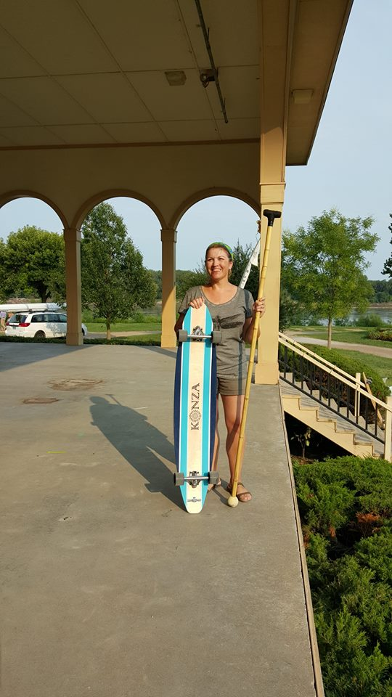
Sponsors (Cont)
J&M Family Enterprises
SCI Engineering
Mitchell James Salon
Ms Judy Mulholland
Konza SUP & Paddle Sports
Ladsurfski

Slide 18
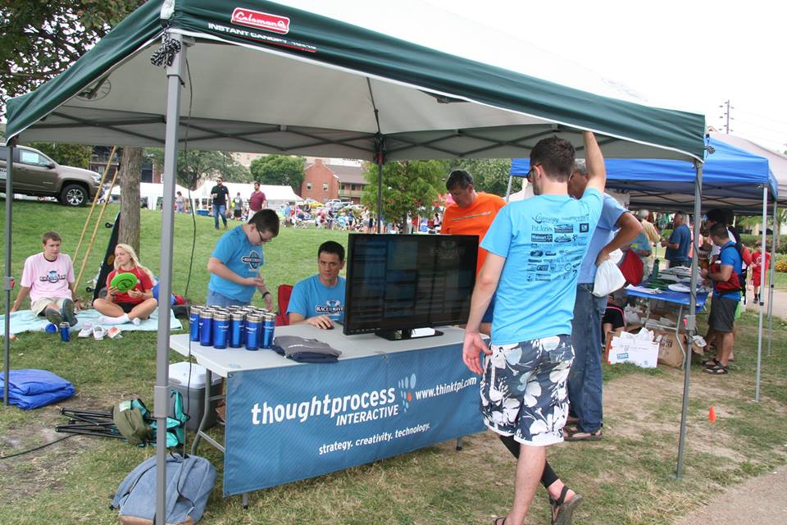
Generous Assistance Provided by
Big Muddy Adventures
Quapaw Canoe Company
St Louis Audubon
Revolution Cycles
Bike Stop Café
Katy Trail Bike Shop
Skajold Vikings
Living History Company
Lake St Louis Water Ski Club
Cities of Wentzville, Dardenne Prairie, Cottleville, St Charles, O’Fallon, St Louis, Bridgeton, Overton, Maryland Heights, Florrisant and St Louis County.
Missouri Department of Conservation
Missouri Stream Team. Stream Team Watershed Coalition and the Mighty 211

Slide 19
2015 Financial Report
Year To Date:
Income $57,506.42
Expenditures $48,298.58
End of Year Assets:$65,851.86
Restricted Funds $ 2,657.00

Slide 20
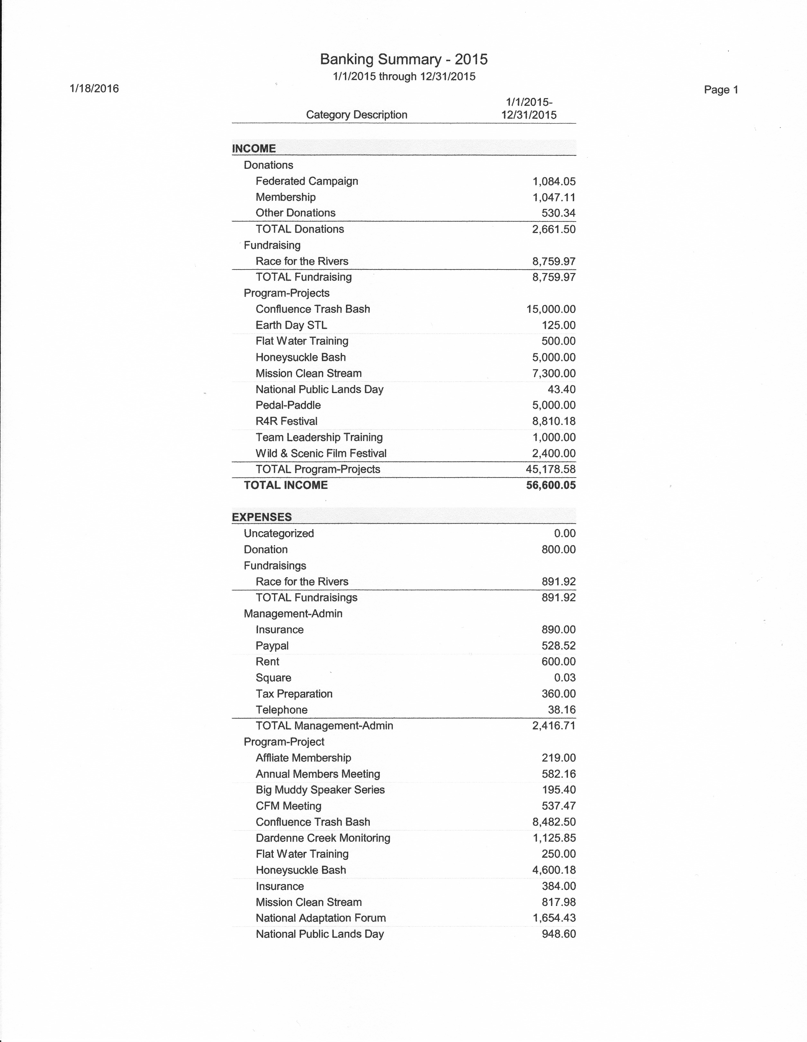
2015 GN Year End Financial Report

Slide 21
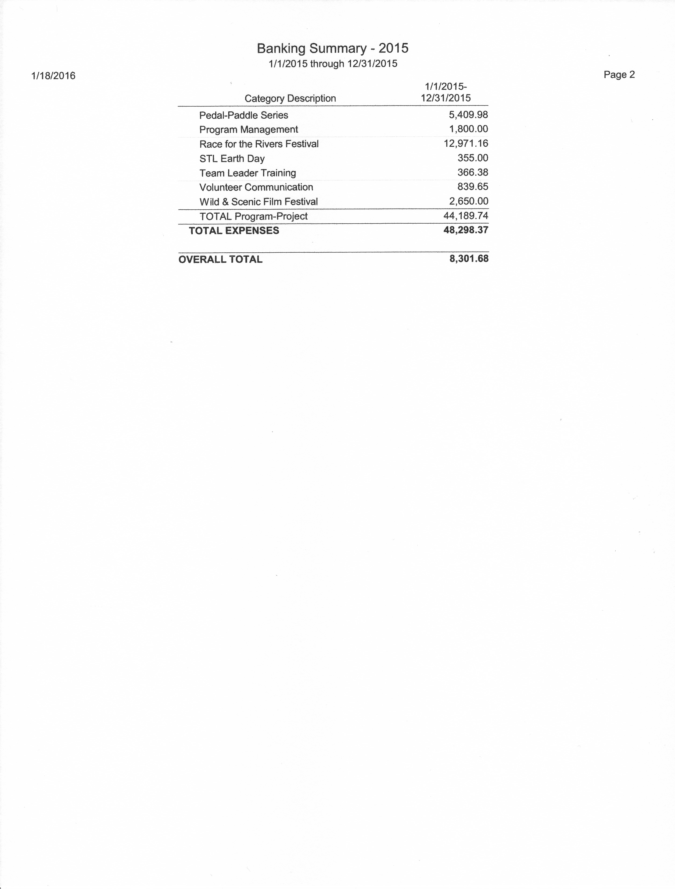
2015 GN Annual Financial Report

Slide 22
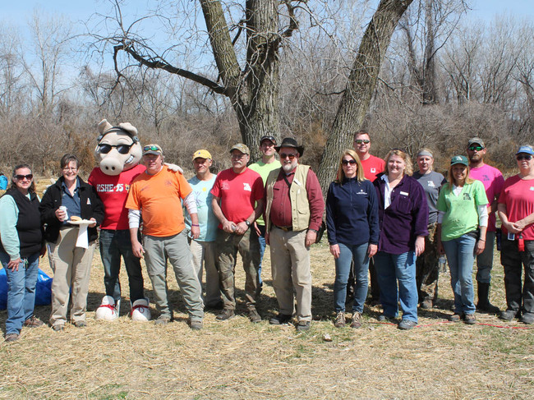
Reach
179 members
1800 Volunteers
4500+ Participants

Slide 23
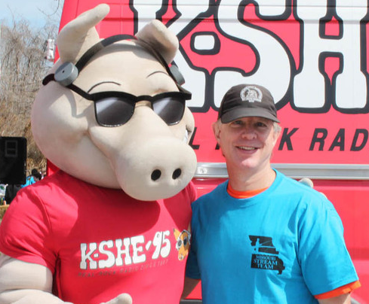
Board
Charlene Waggoner, President
Greg Poleski, Vice President
Abby Broadstone, Vice President, Membership
Larry Ruff, Treasurer
David Hartman, Secretary
Jessica Rowe, Historian
Mike Garvey, Director
Sharon Kenny, Director
Mike Claspille, Director

Slide 24
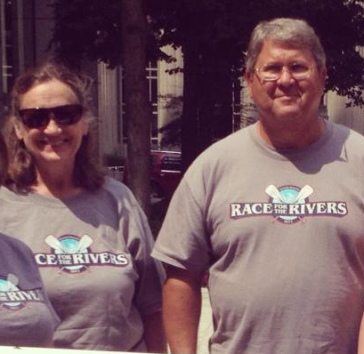
Special Recognition
Sharon Kenny
Dave Hartman
Bob Virag

Slide 25
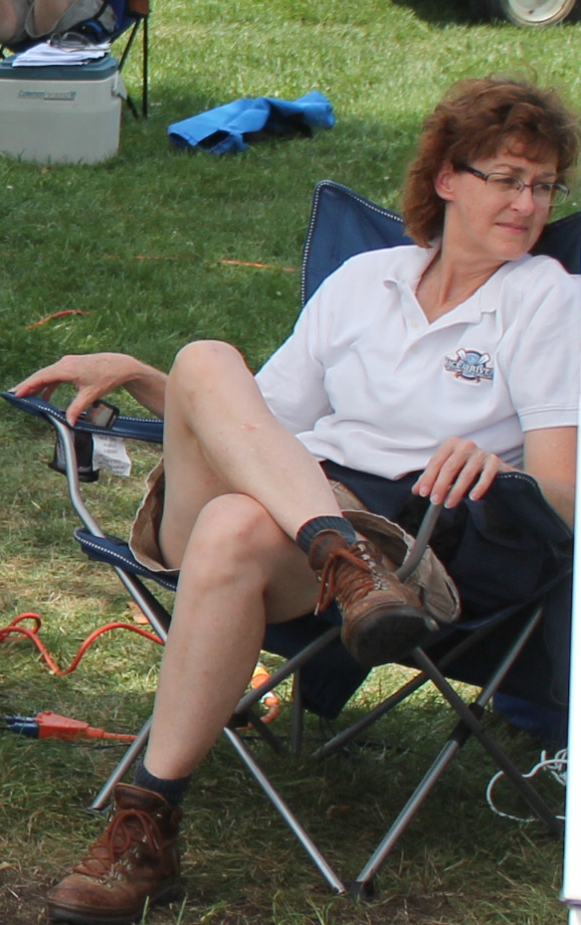
Pat Jones Volunteer 2015
Laura Schneier

