Slide 1
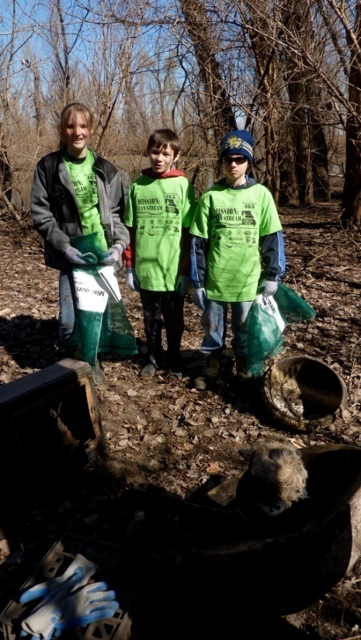

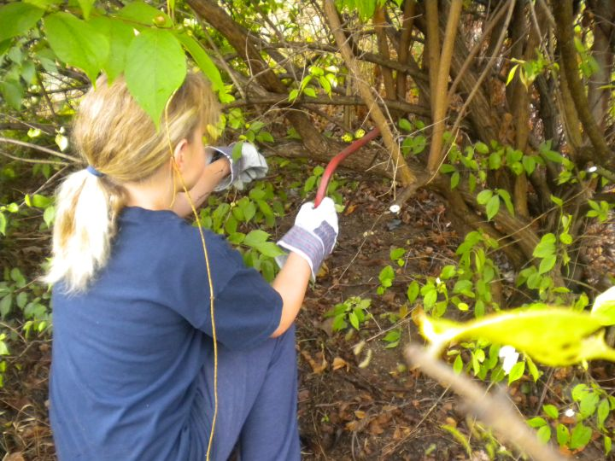
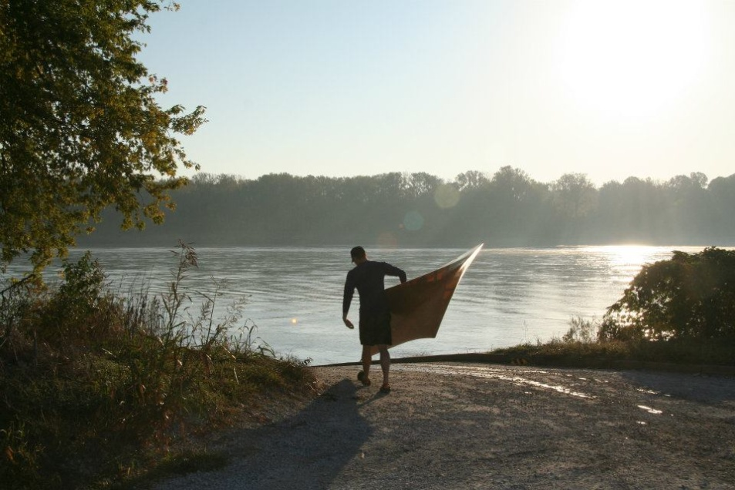
Annual Meeting 2014

Slide 2
GN Board of Directors
President: Charlene Waggoner
Vice President Membership: Abby Broadstone
Vice President Revenue: Greg Poleski
Secretary: David Hartman
Treasurer: Larry Ruff
Parliamentarian: Jessica Rowe
Michael Garvey
Sharon Kenny

Slide 3
Mission Statement
Our Mission is to conserve natural resources, encourage sound management of the watersheds, and protect the quality of life for the residents of the St. Louis Region. We do that by creating a network of communication and consensus among citizens, government leaders and other organizations which share our goals. Most of all, we encourage everyone to 'act locally' to make it happen.

Slide 4
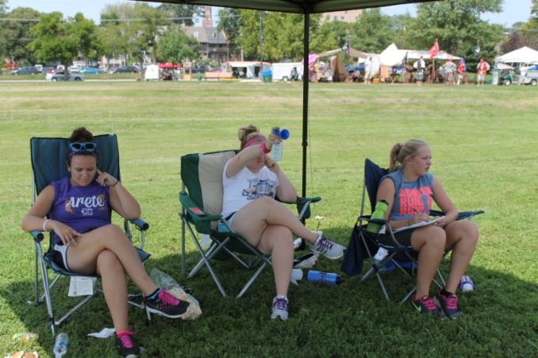
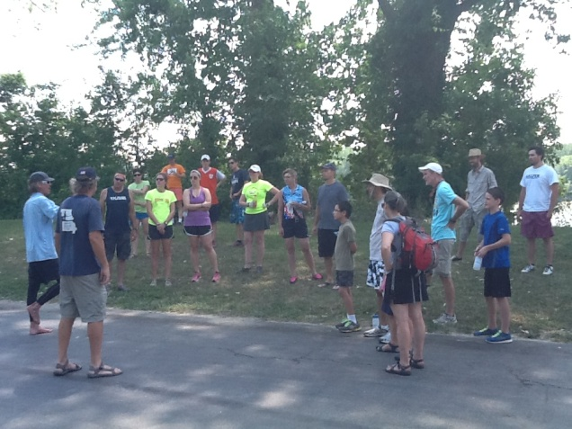
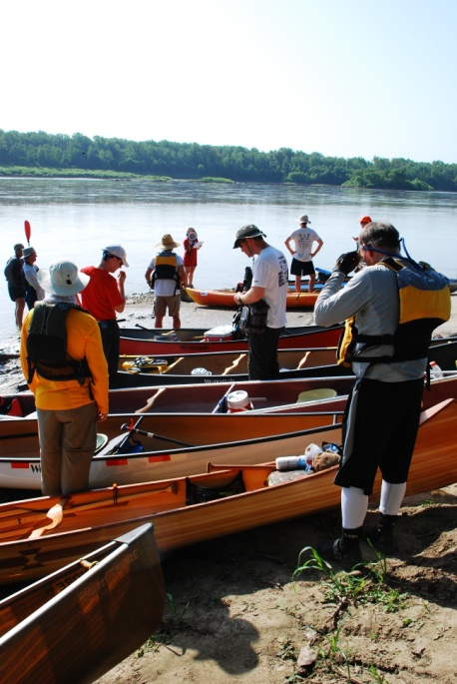
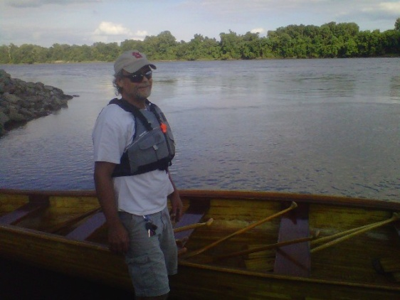
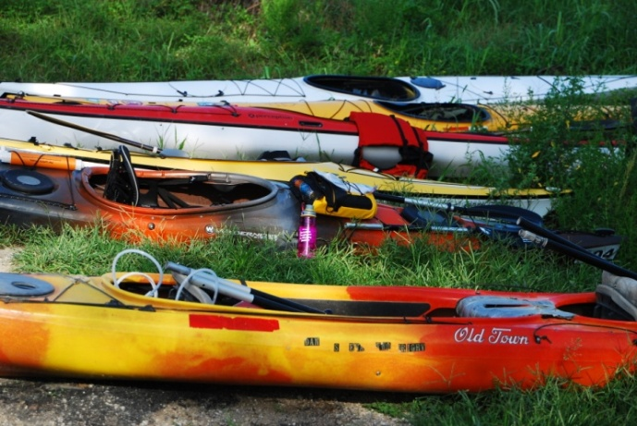
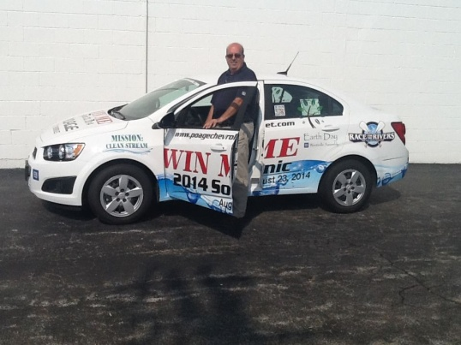
Agenda
Welcome
Introduce Special Guests
Meal
Annual Report
Election of Officers
Special Recognitions

Slide 5

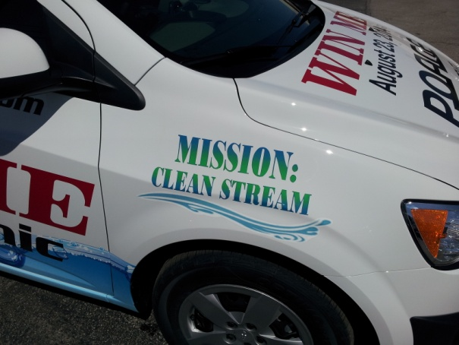
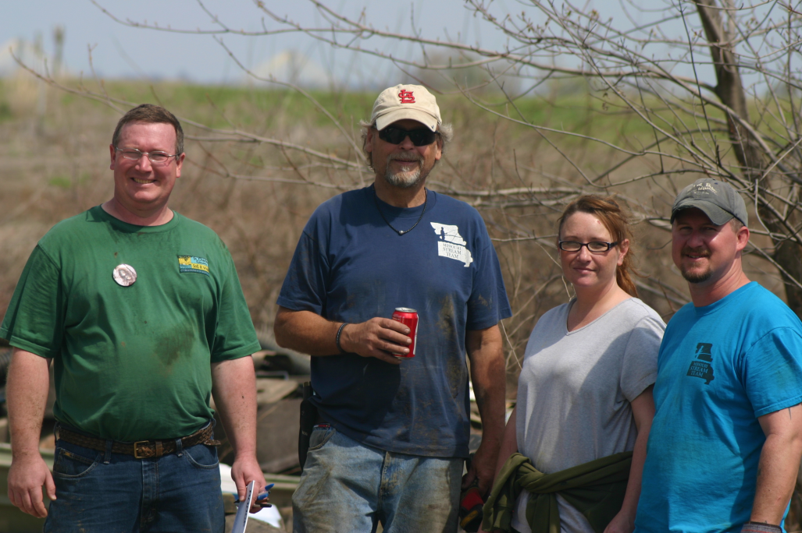
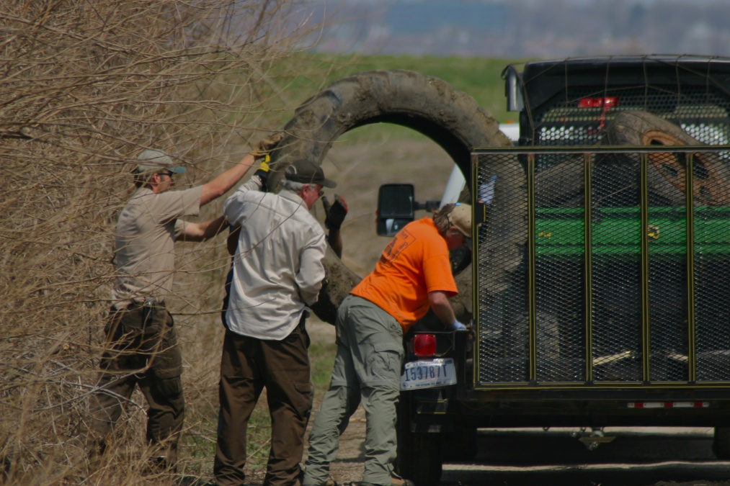
953 participants
53 sites
50 tires
14,000* pounds of trash

Slide 6

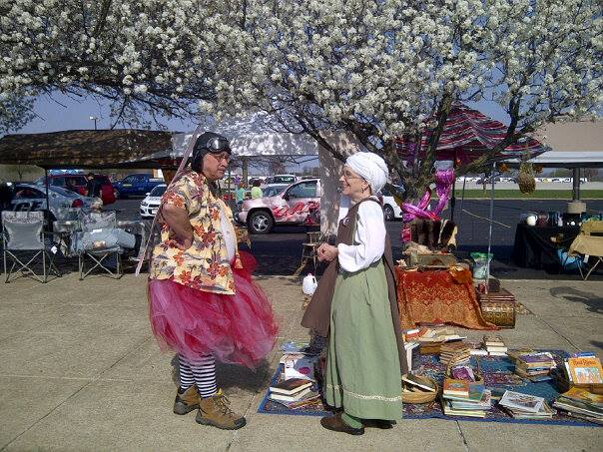
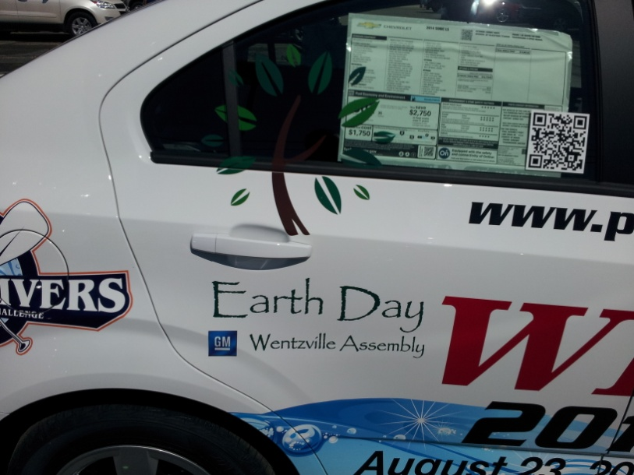
GM Earth Day
Green Heroes Program
500 participants

Slide 7
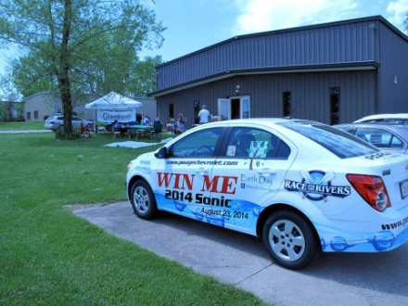
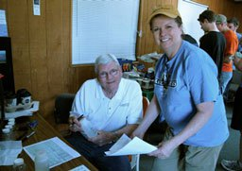
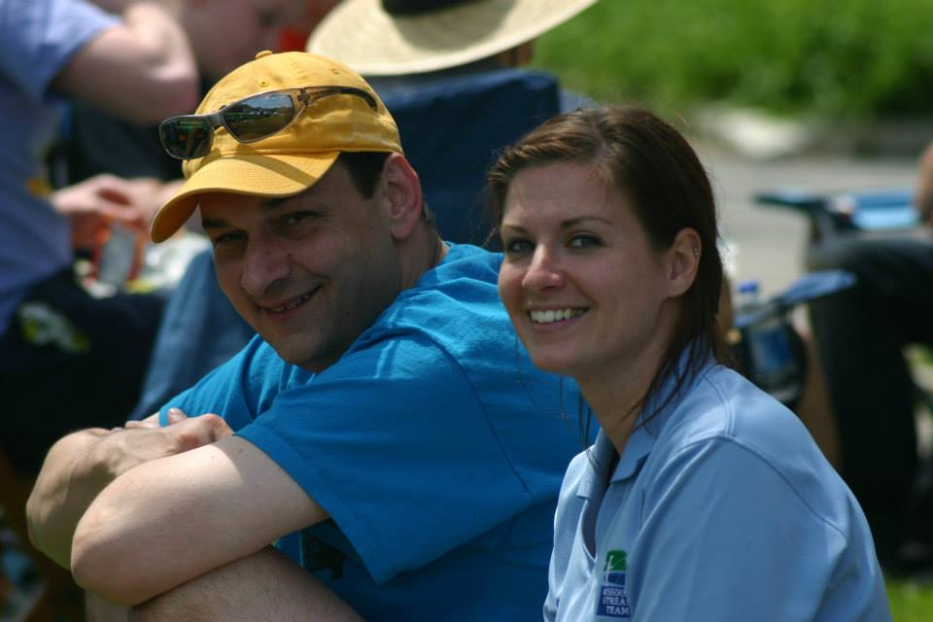
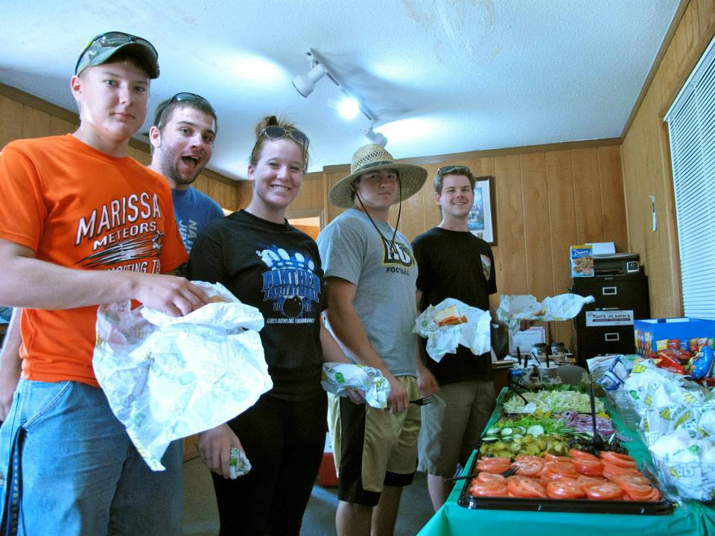
Dardenne Creek Monitoring
19 sites on the creek monitored
29 volunteers
9 different Stream Teams

Slide 8
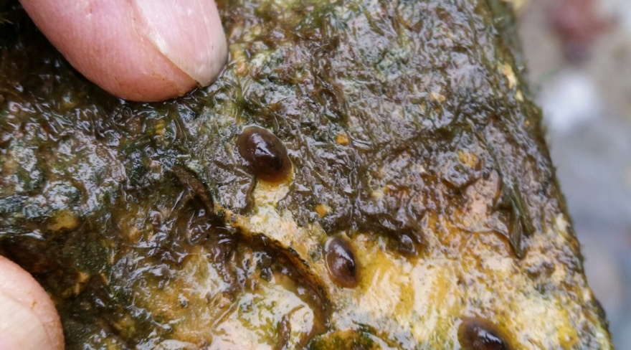
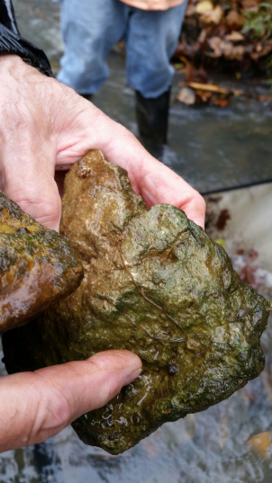
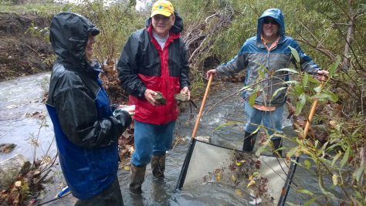
Dardenne Creek Monitoring Fall
16 sites monitored
10 volunteers
5 Stream teams

Slide 9
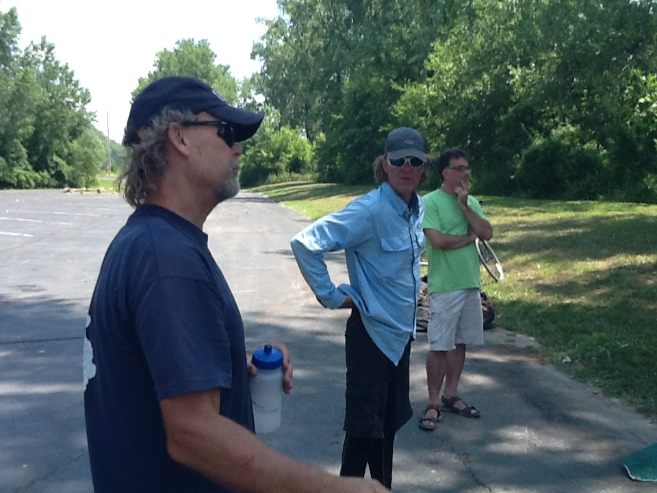
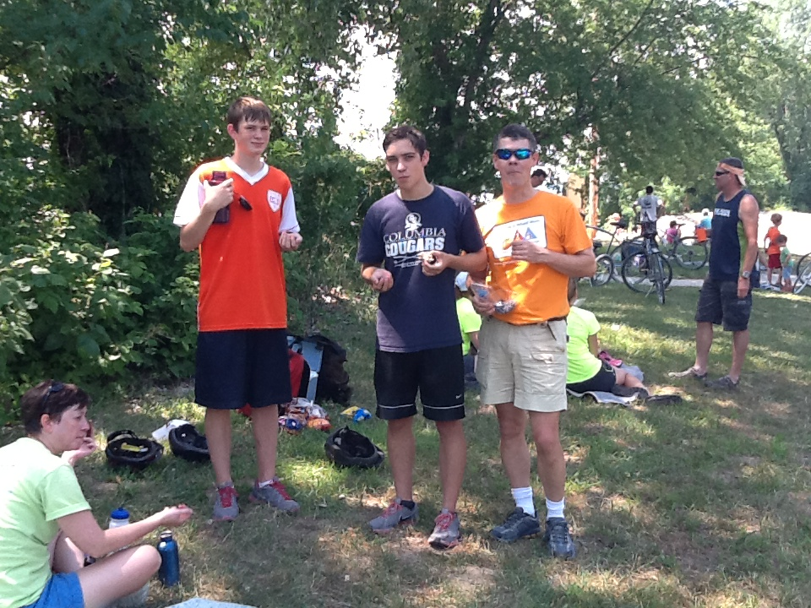
MO River Pedal and Paddle
“SOLD” OUT!
Grant from Great Rivers Greenway
Katy Bike Rental
Big Muddy Adventures

Slide 10
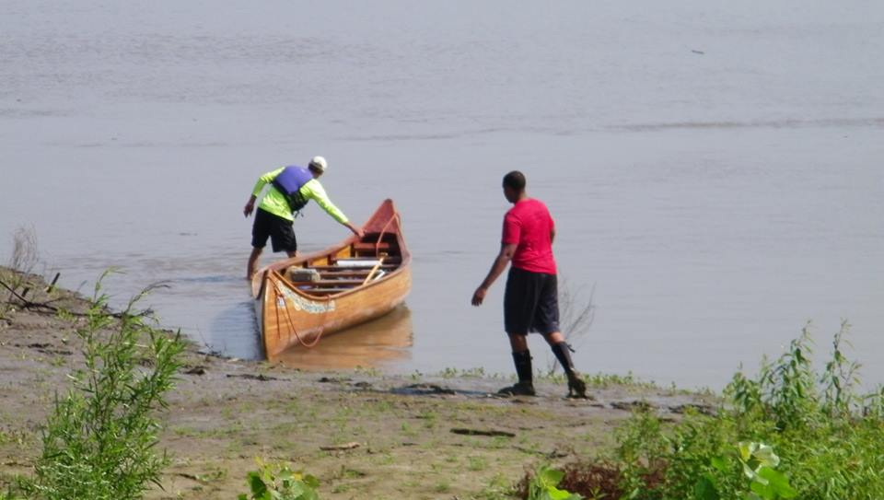
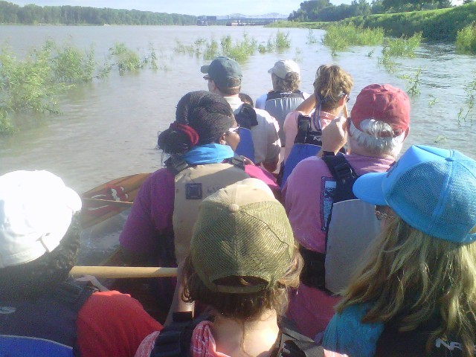
Big Muddy Speaker Series
Monthly Meetings on Wednesday Nights at Big A’s
Knowledgeable Speakers Lead a Discussion About Various River Management Topics
Preceded by a Free Voyageur Canoe Float on the Missouri

Slide 11
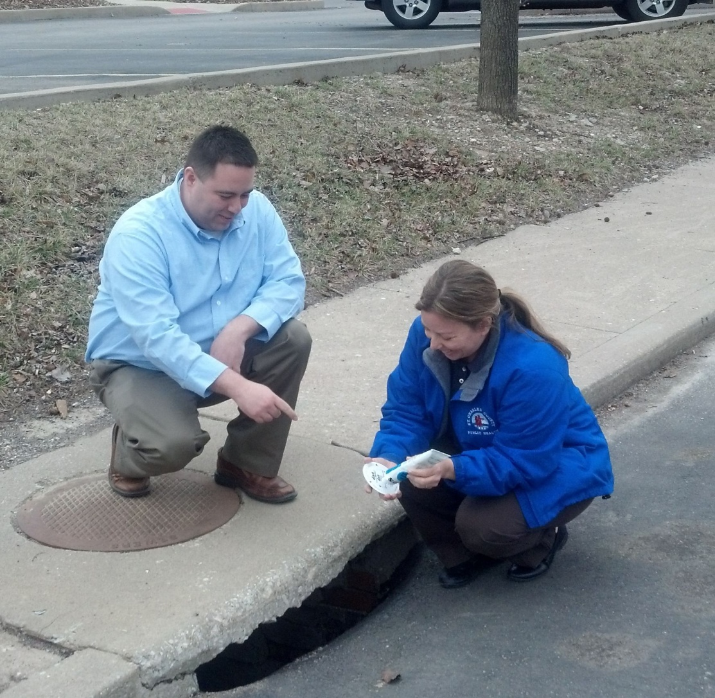

Storm Drain Marking Project
Conducted in Partnership with St. Charles
County Health Department
Goal is to Mark 9000 Drains Over the Next Couple of Years in St. Charles County

Slide 12
Festivals and Educational Events
Earth Day St Louis
National Trails Day
Washington Riverfest

Slide 13
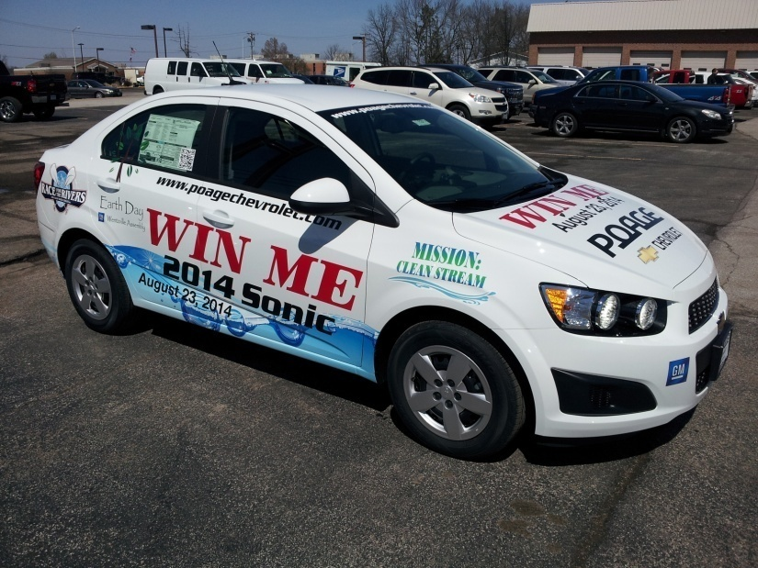

Poage Chevrolet #whereismysonic
Winner - Gary Reidel

Slide 14

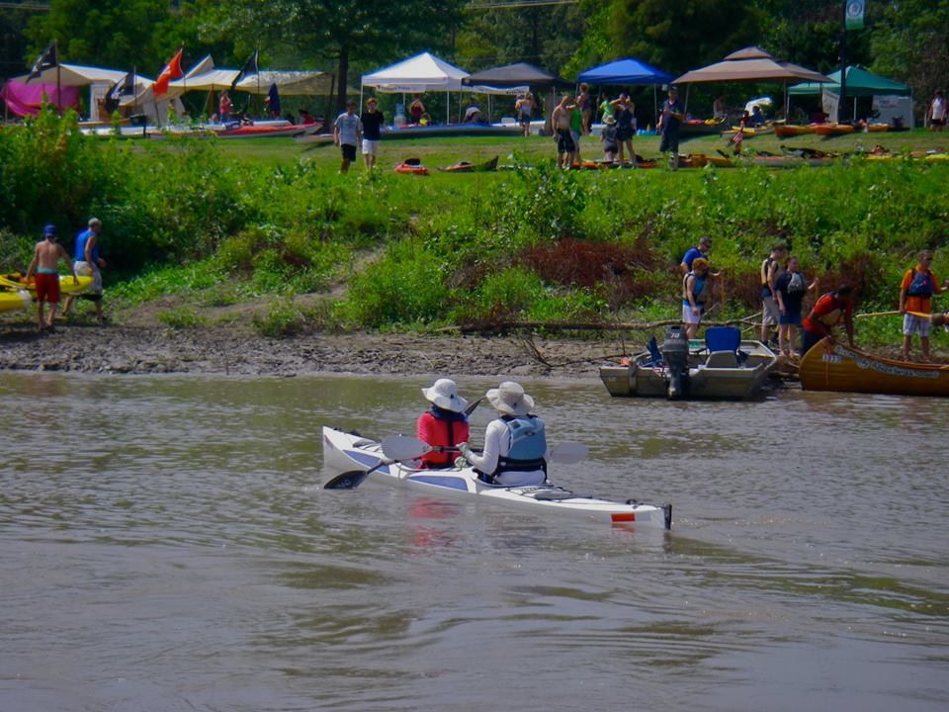
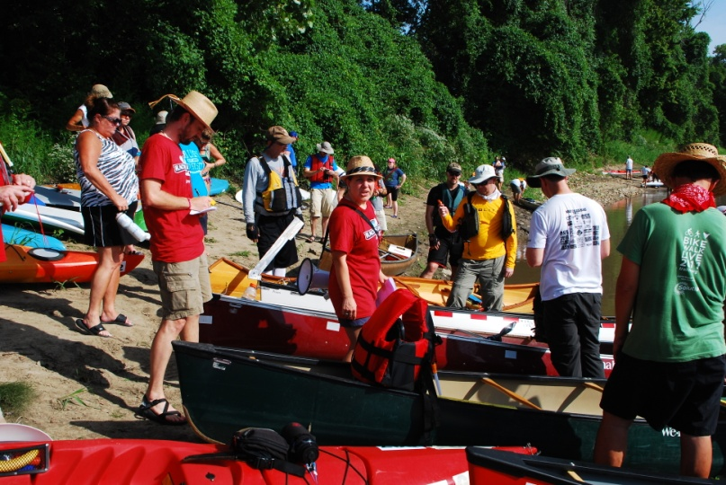
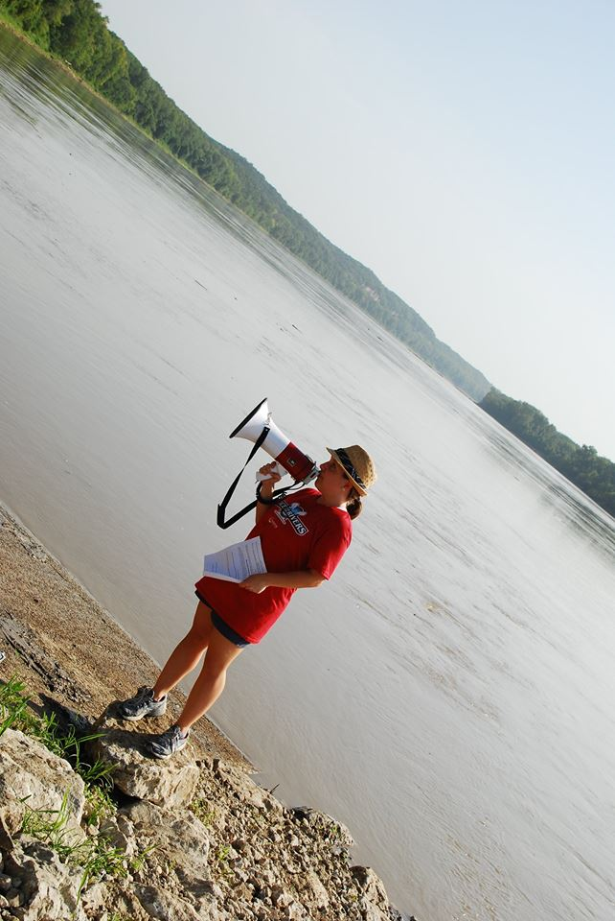
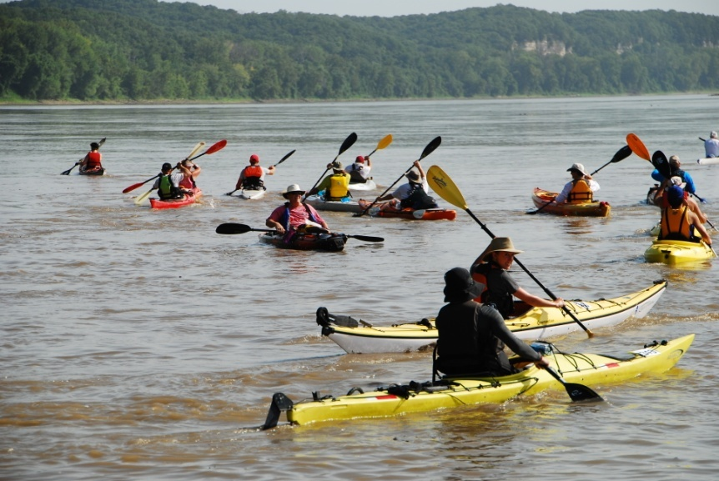
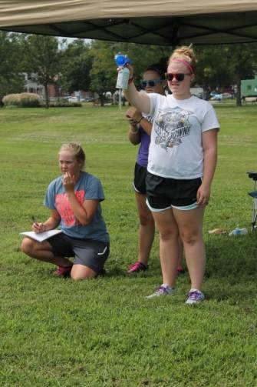
100 + boats pre-registered
Emm…It was hot!

Slide 15
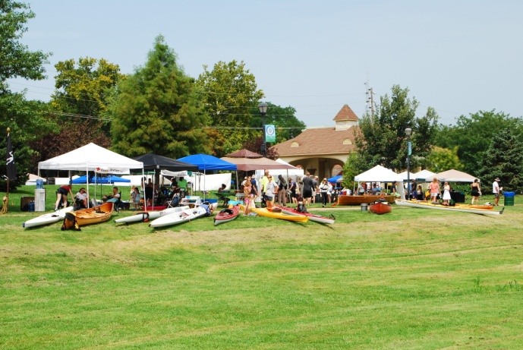

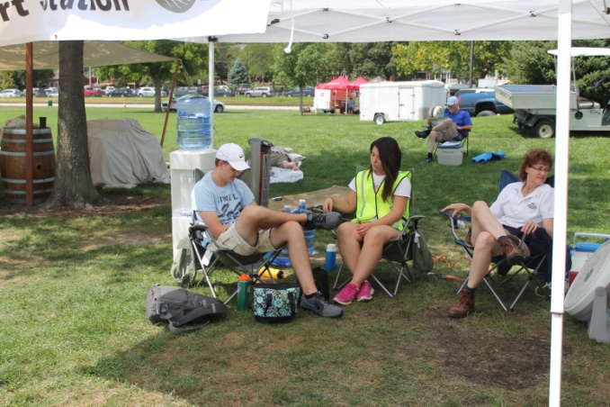
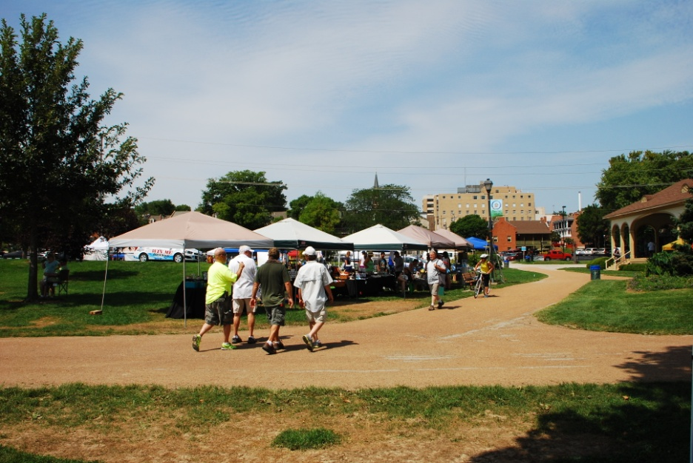
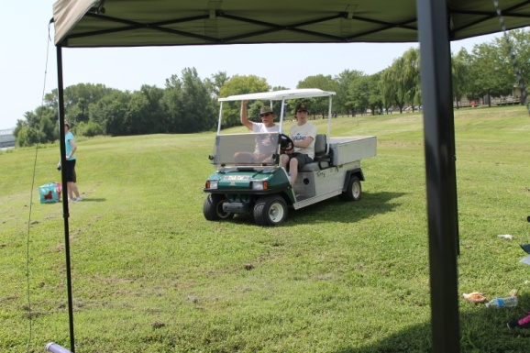
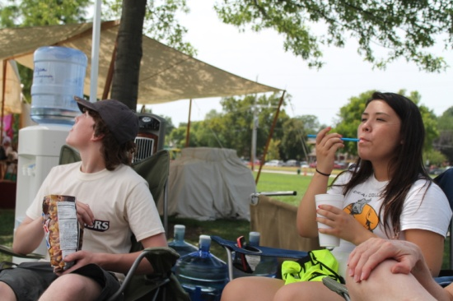
850 attendees
New Sponsors – Leinenkugel/Sauce
New Shuttle for Boats
Missouri River Excursions
Car Raffle
Best festival Layout yet.
Emm… it was hot….

Slide 16
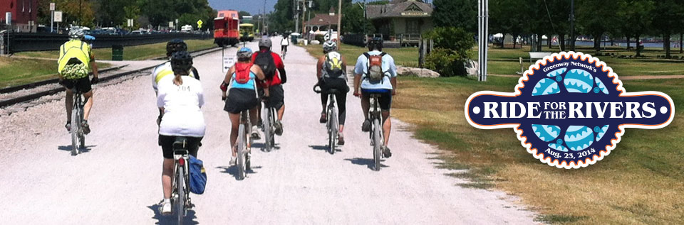
Ride for the Rivers
More Registrations!
Revolution Cycles
Katy Trail Bike Rental
Bike Stop Cafe
Erm… It was HOT.

Slide 17
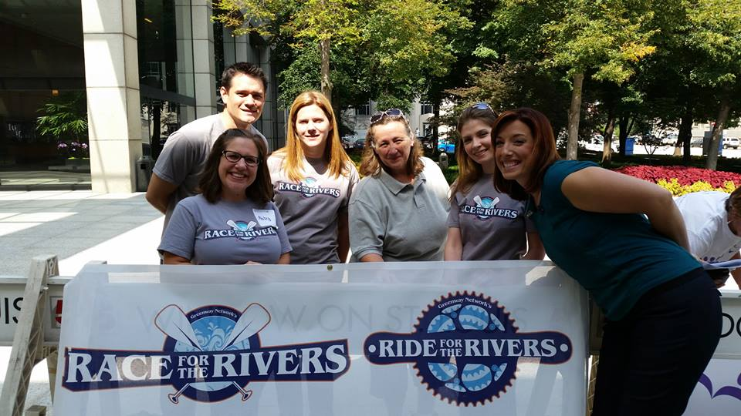
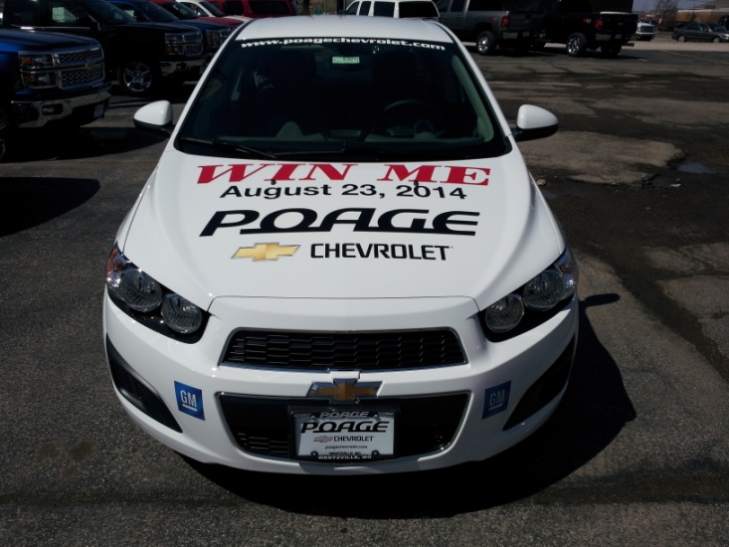
Media
Facebook
  Greenway Network 126
  Race for the Rivers 479
  Mission Clean Stream/GM Earth Day 831
  Confluence Trash Bash 476
Radio and TV
Sauce Magazine
Constant Contact

Slide 18

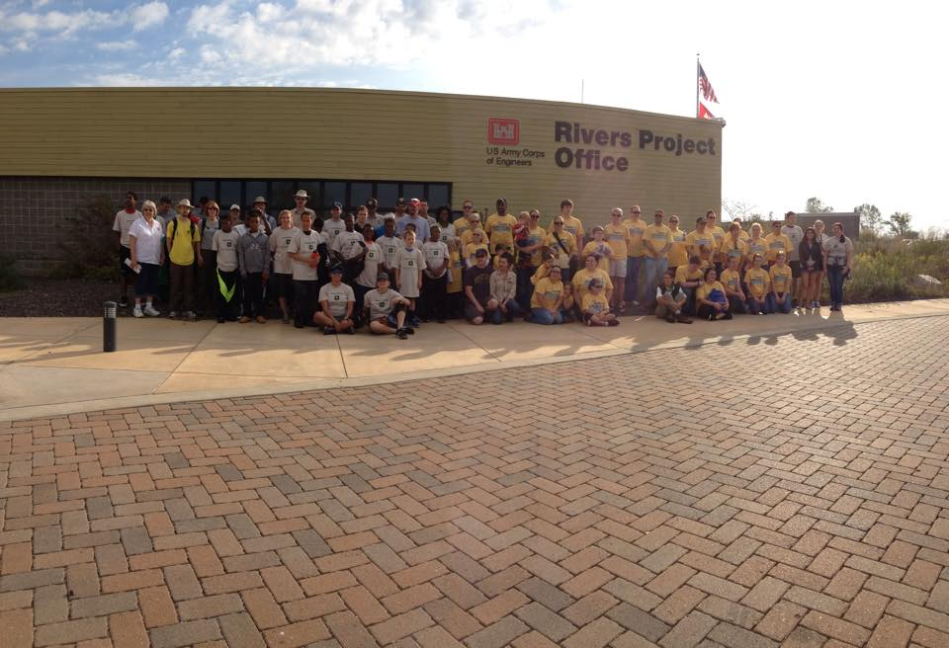
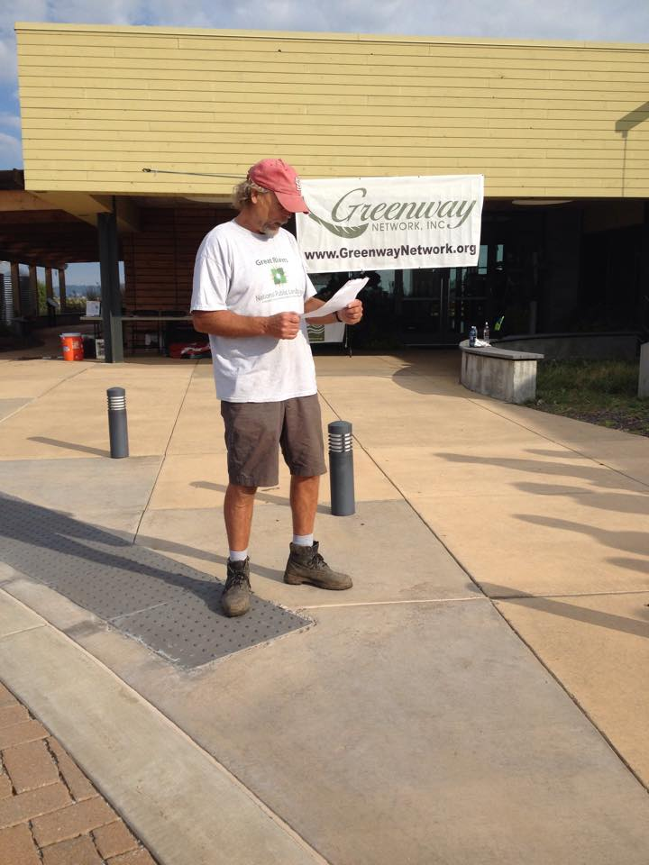
National Public Lands Day
75 Participants
650 trees planted
Big Muddy Adventures paddle

Slide 19
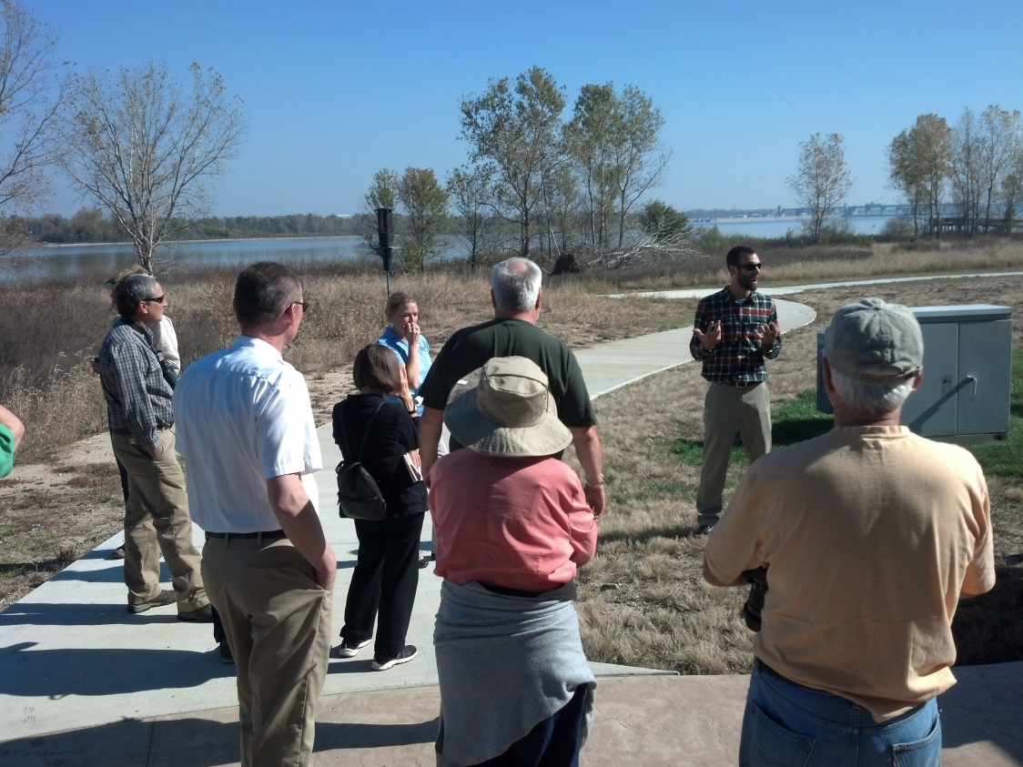
River Soundings
4 speakers
35 participants
At Riverlands

Slide 20
Financial
2014
Income $33,440.08
Expenses $30,989.62
Total Assets: $56,644.02
  Programs/Projects: 87%
  Fundraising: 3%
  Administrative costs: 18%

Slide 21
2014 GN Yearly Financial Report
Greenway Network Yearly Financial Summary
1/1/2014-12/31/2014
Opening Balance $54,193.56
INCOME
Donations
Federated Campaign 1,023.94
Membership 885.00
Other Donations 40.00
TOTAL 1,948.94
Fundraising
Race for the Rivers 7,315.06
TOTAL Fundraising 7,315.06
Programs-Projects
Grants 3,000.00
Mission-Clean Stream 10,841.00
National Public Lands Day 500.00
Race 4 the Rivers Festival 9,835.08
TOTAL Programs-Projects 24,176.08
TOTAL INCOME 33,440.08
EXPENSES
Bank Charge 82.62
Charity 400.00
Fundraising
Race for the Rivers 1,446.25
TOTAL Fundraisings 1,446.25
Management-Administration
Insurance Board of Directors 488.00
Paypal 480.72
Rent 1,200.00
Square 3.14
Tax Preparation 360.00
Telephone 232.35

Slide 22
2014 GN Yearly Financial Report continued
TOTAL Management-Administration 2,764.21
Program-Projects
Affiliate Membership 209.00
Annual Members Meeting 491.21
Big Muddy Speaker Series 2,544.18
Confluence Trash Bash 76.00
Conservation Federation meeting 125.15
Dardenne Creek Monitoring 1,387.26
Mission Clean Stream 422.95
National Public Lands Day 740.45
Peddle-Paddle Series 2,850.00
Program Management 2,355.36
Race for the River Festival 12,526.38
River Soundings Symposium 386.60
STL Earth Day 454.00
Storm Drain Marking 90.00
Tree Planting 1,050.00
Volunteer Communication 588.00
TOTAL Program-Projects 26,296.54
TOTAL EXPENSES 30,989.62
Ending Balance OVERALL TOTAL $56,644.02

Slide 23
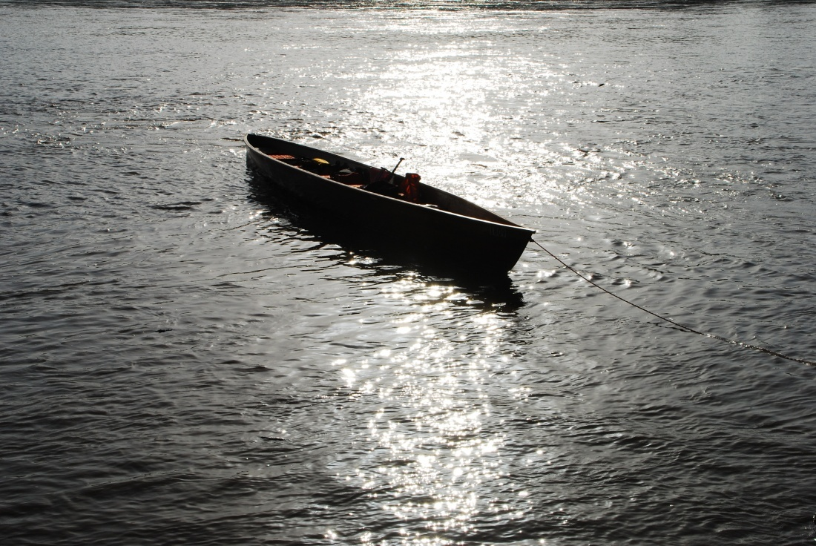
Sponsors
  Thought Process Interactive
  Mrs Pat Jones
  Great Rivers Greenway
  GM Wentzville
  Poage Chevrolet
  Walmart Wentzville
  Leinenkugel and Sauce Magazine
  Earth Shares Missouri
  JM Family Enterprises
  SCI Engineering
  Sam’s Club
  Mitchell James Salon
  Judy Mulholland
  And memberships and contributions from participants like you!

Slide 24
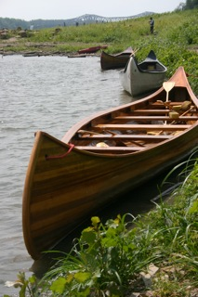
Events 2015
Confluence Trash Bash
  March 21, 2015
Mission: Clean Stream/GM Earth Day
  April 11, 2015
Dardenne Days
  May and Oct
Race for the Rivers
  August 29, 2015
Big Muddy Speaker Series
River Soundings
St Charles County Storm Drain Marking

Slide 25
Special
Recognition
Stacey Schelske
Ollie Langhorst

Slide 26
Honored Network Affiliate
Big Muddy Adventures – Mike Clark

Slide 27
Pat Jones Volunteer of the Year:
Kathy LaChance

